Slide 1

NB Power’s 45 Day Challenge
Darren Murphy, CFO & Senior VP Corporate Services

Slide 2


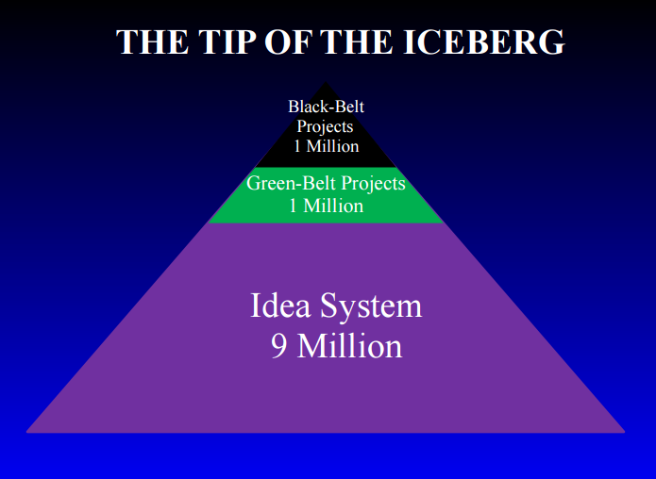
How do we increase the number of improvement opportunities per employee?

Slide 3


Slide 4
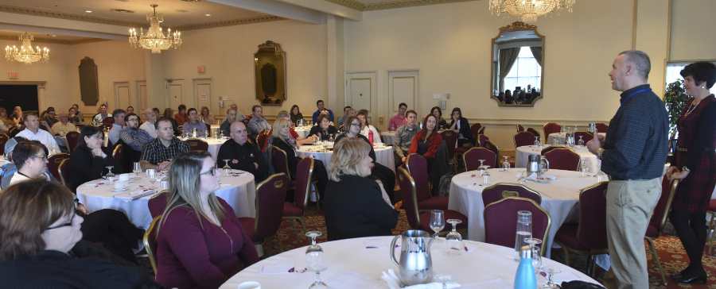
The Kick-Off

Slide 5
45 Day Challenge
(The Ask)
I will:
Identify and make at least 1 local improvement over the next 45 days
Confirm implementation date and savings for each improvement
Record your improvement in the Continuous Improvement Hub
Help your team and colleagues complete the challenge

Slide 6
The Results

Slide 7
99 improvements made
84 individuals entered improvements
Created buzz with the 45 Day Challenge
Celebrated successes with videos
Overhauled our Opportunity List and created the Continuous Improvement Hub

Slide 8
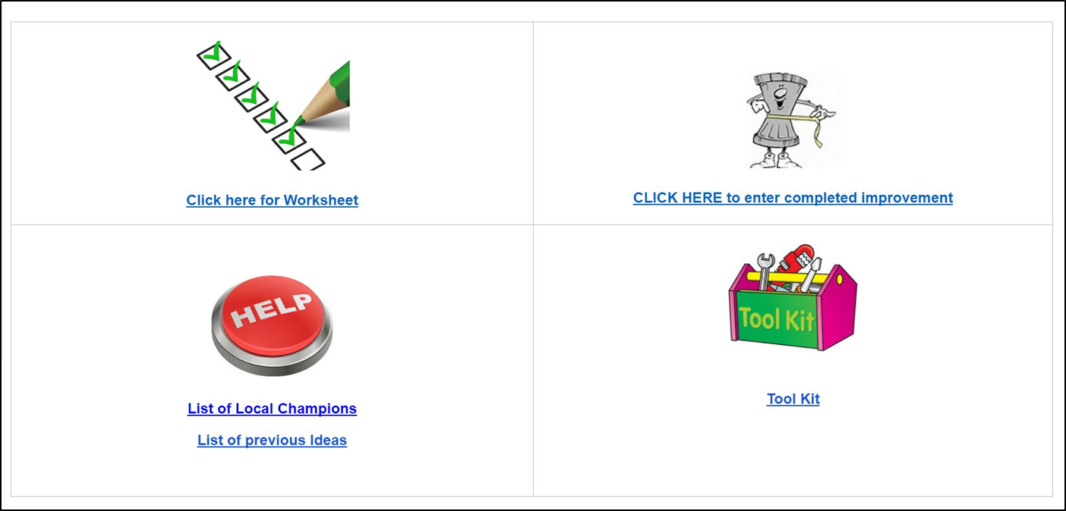
Employee Continuous Improvement Hub

Slide 9

Recycling Office Furniture
$3,100

Slide 10
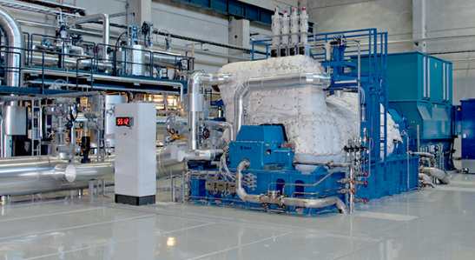
Efficient use of Station Equipment
$42,000

Slide 11
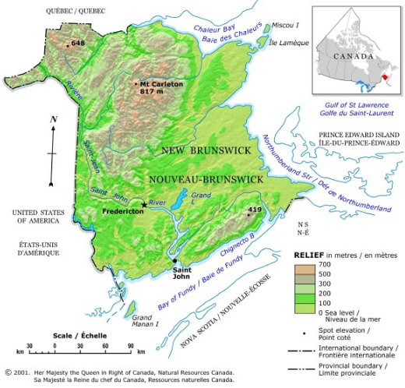
Leveraging DNR Aerial Services for Mapping
$300,000

Slide 12
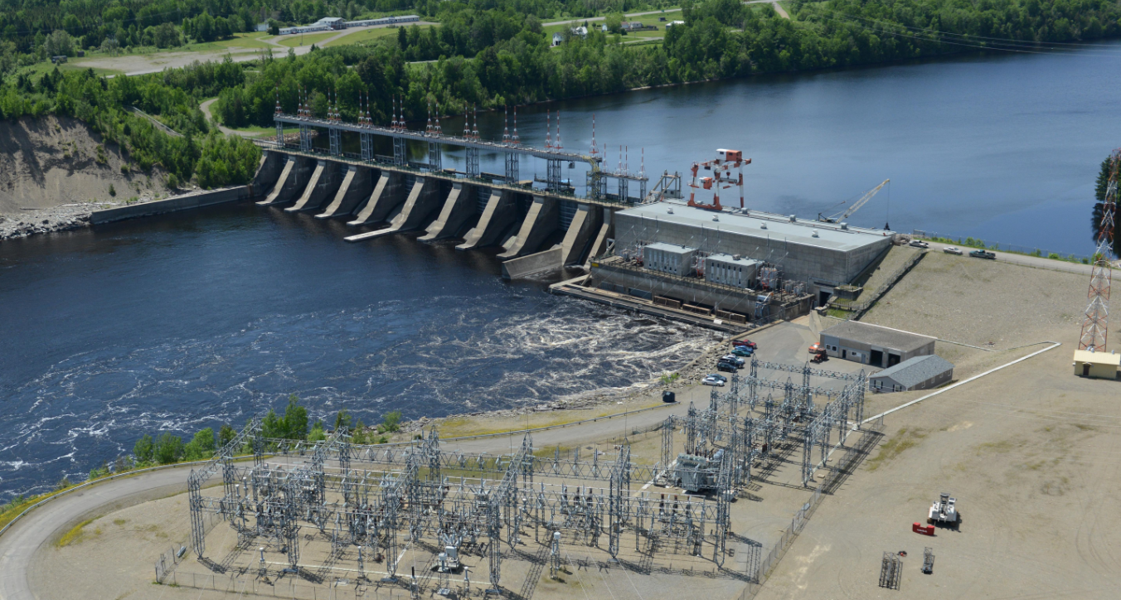
Beechwood water resource optimization
$200,000

Slide 13

Return of unused devices
$516

Slide 14

Stop Printing the Adjustment Form
$42
Notes:
Reduced unnecessary printing for purchasing

Slide 15
$2,100,000!!!

Slide 16
Continuing the momentum

Slide 17

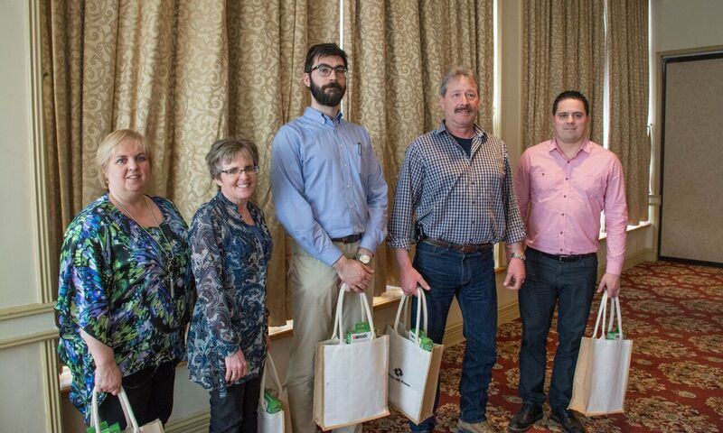

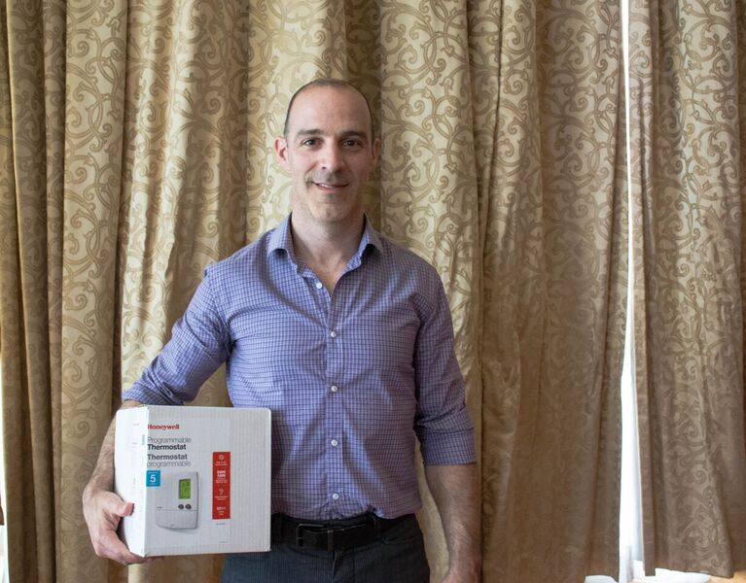
Celebrating Success

Slide 18
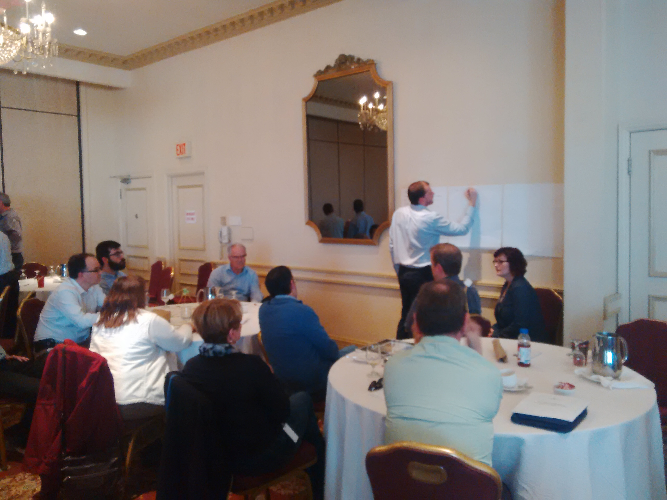
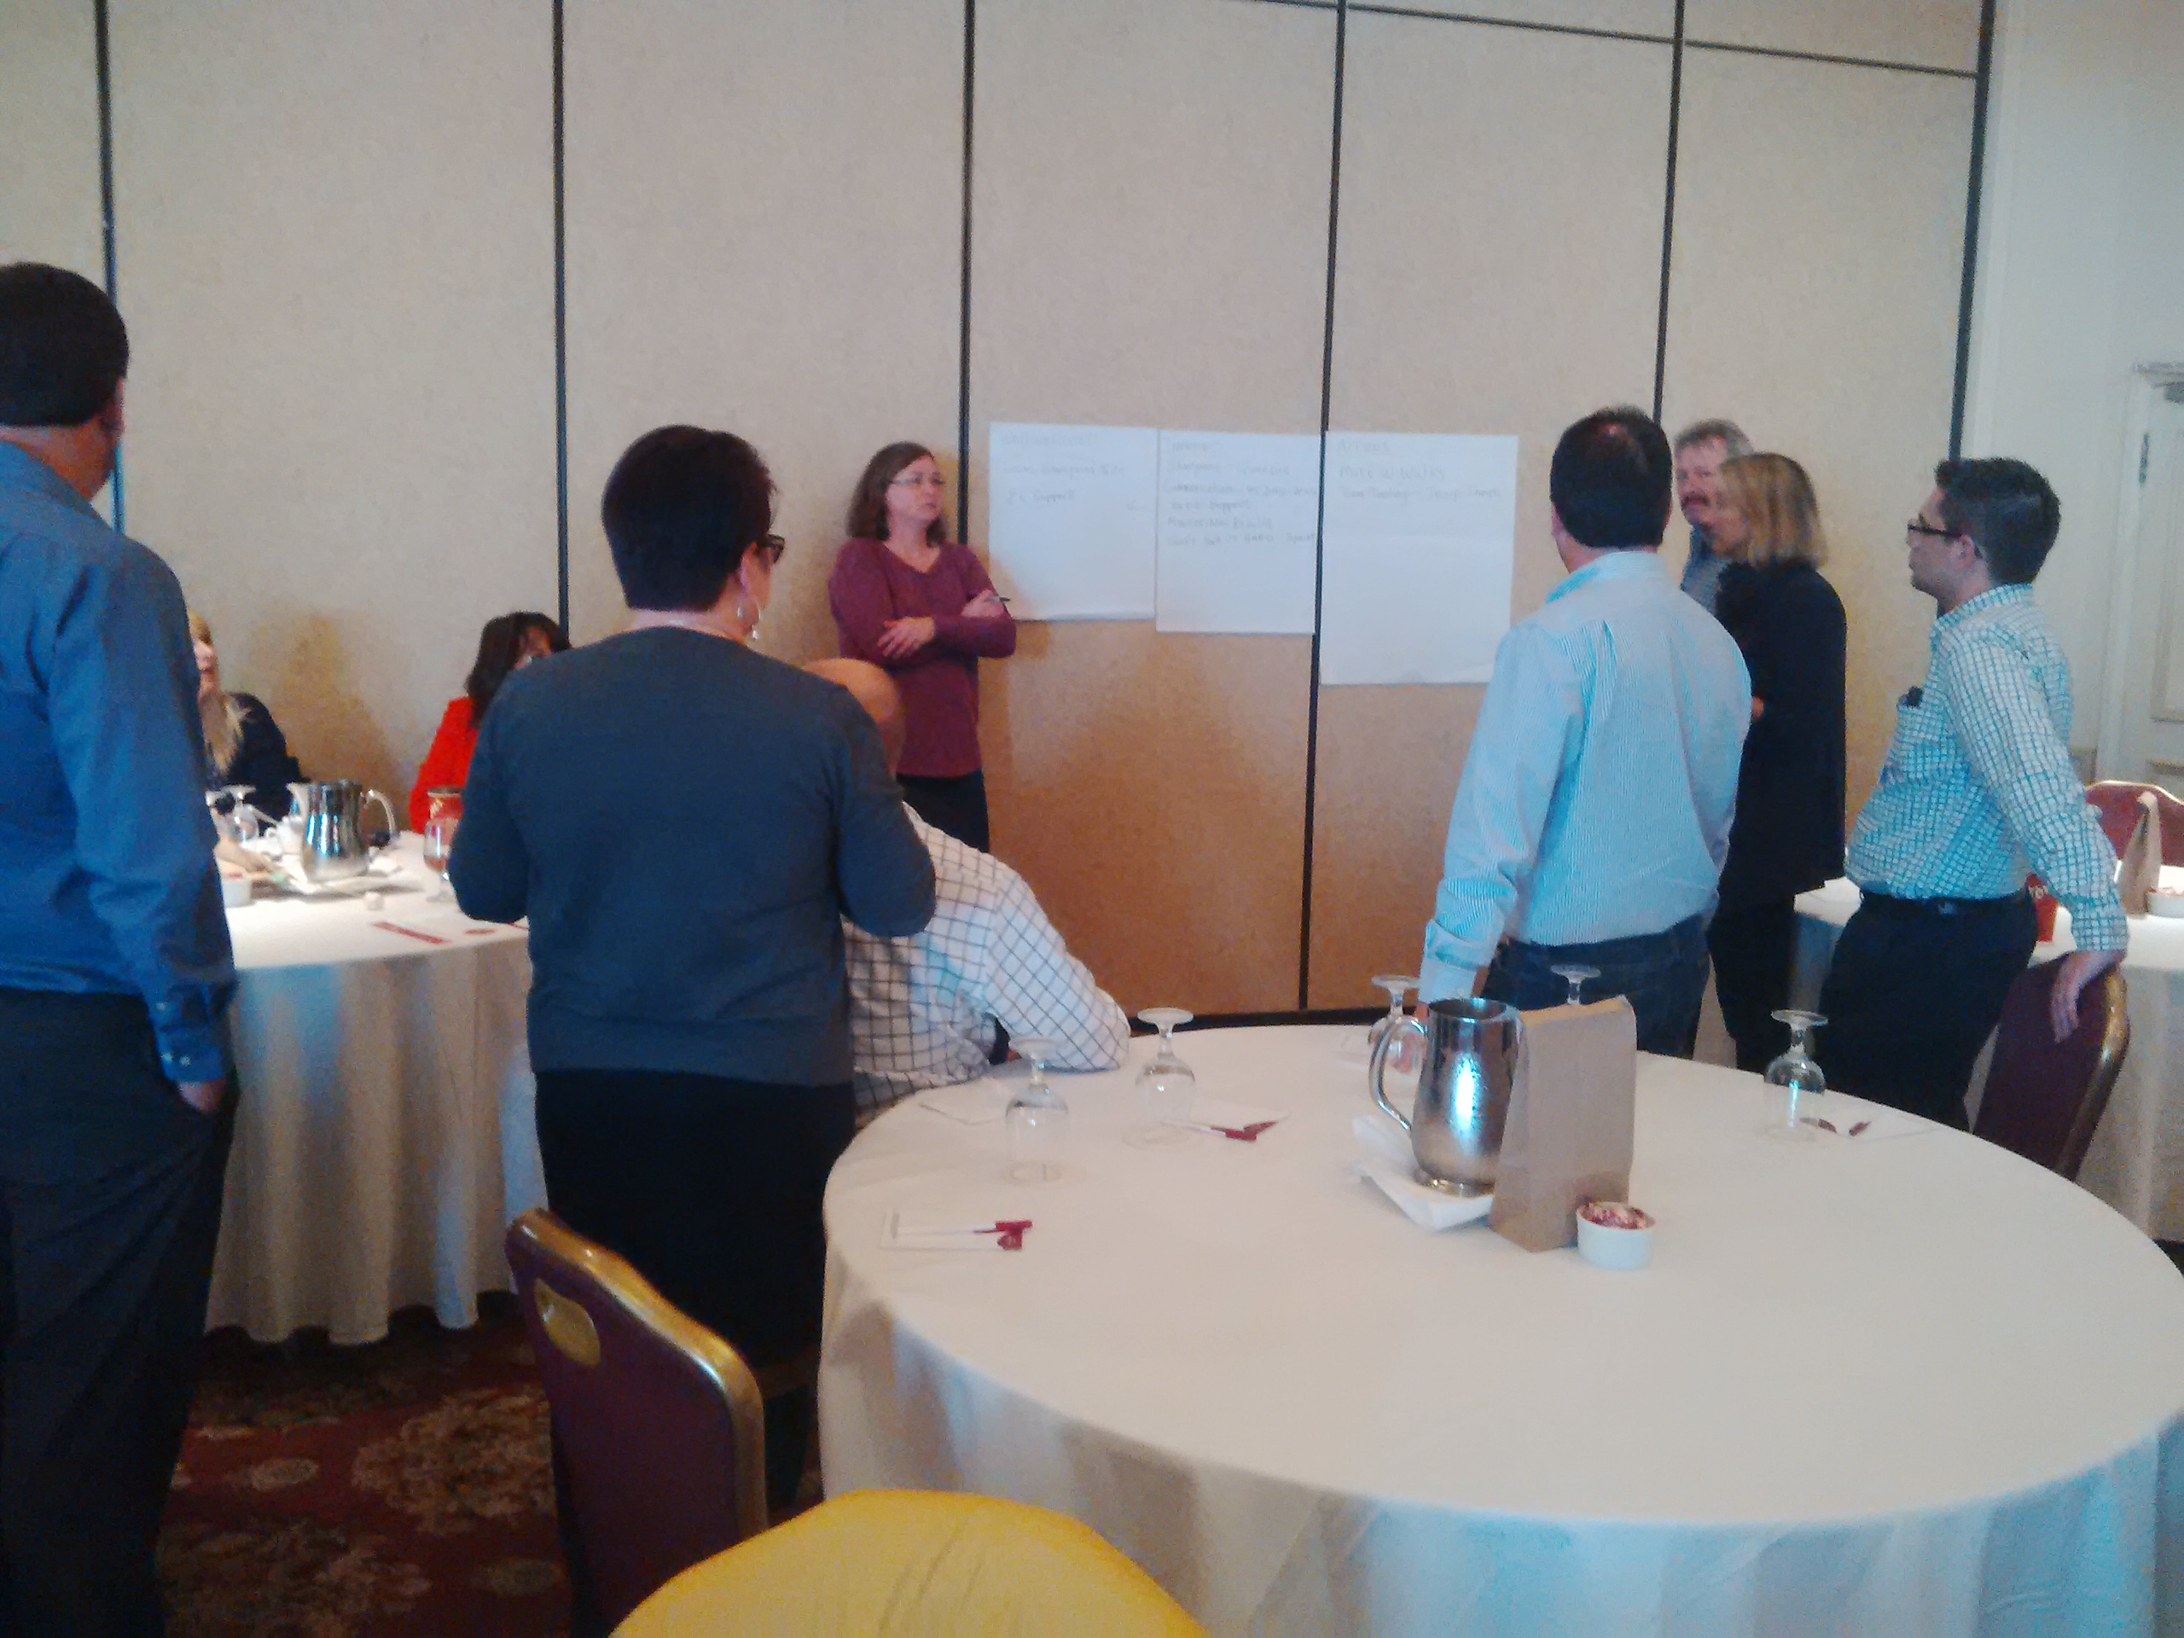
De-brief and next steps

Slide 19
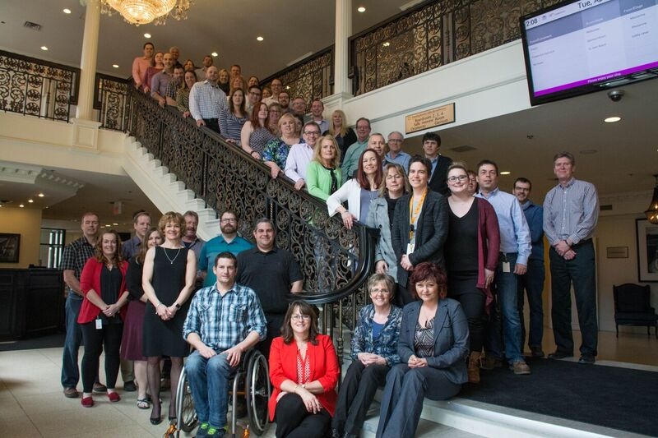

Slide 20
Thank you

