Slide 1
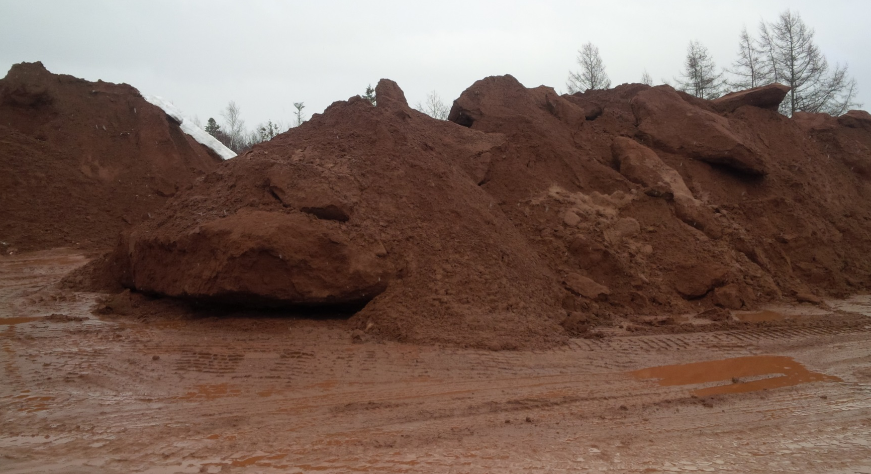
Winter Sand Quality Assurance and Storage
Department of Transportation and Infrastructure
Operations Branch
May 2015 – January 2017

Slide 2
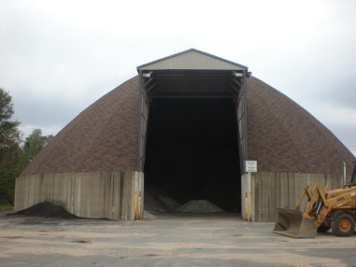
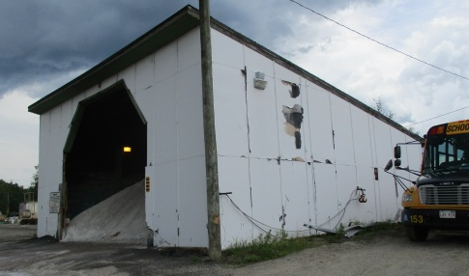
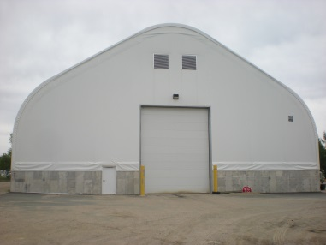
Background
NBDTI plans, designs, operates and maintains an extensive network of 18,785 km of highway
6 Districts with 93 winter depots

Slide 3
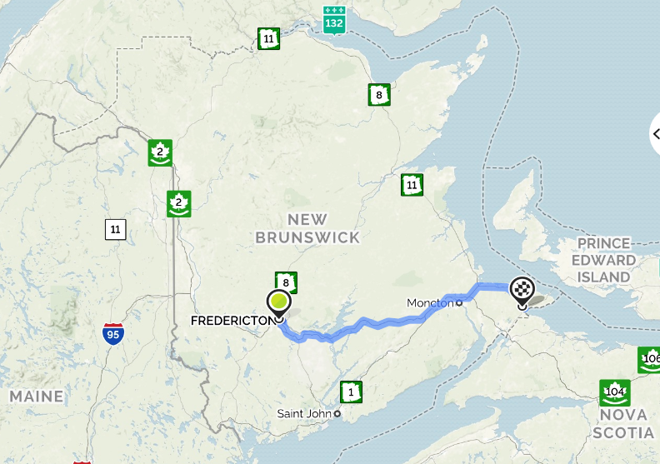
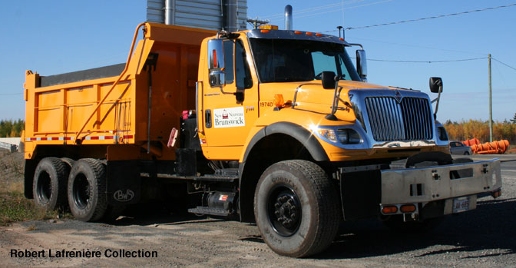
Winter Sand: 301,000 tonnes / year
11t per DTI truck
27,364 trucks
241km (150mi)
8.8m (29ft)
Fredericton to Port Elgin
OR
Montreal to Quebec City
Notes:
10 year average sand usage 301,000 tonnes / year
10 year average salt usage 147,500 tonnes / year

Slide 4
Problem Statement
Sand was clumping due challenges with storage techniques and quality control.
= Wasted time and fuel
= Wear and tear on equipment
= Risk of increased employee accidents
= Re-sanding roads

Slide 5
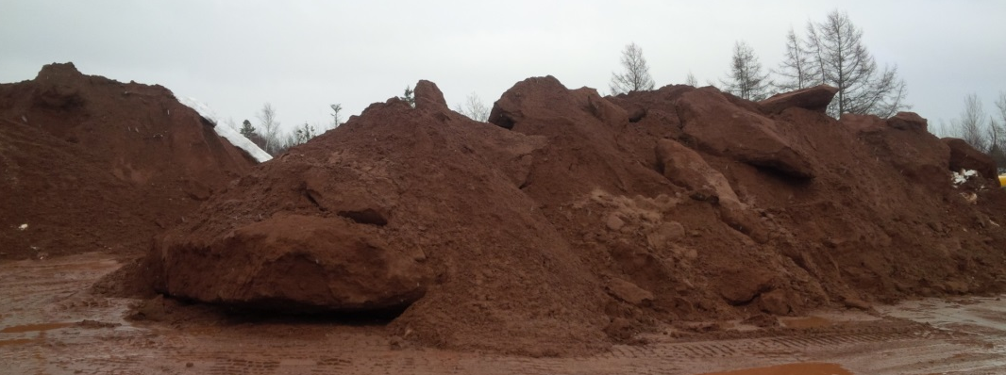
Goal
Develop solution to mitigate sand clumping
Create consistent approach for mixing and application

Slide 6
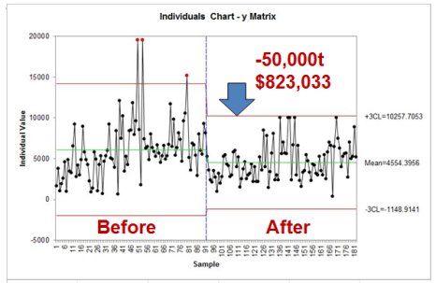
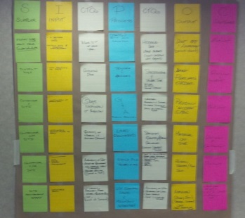
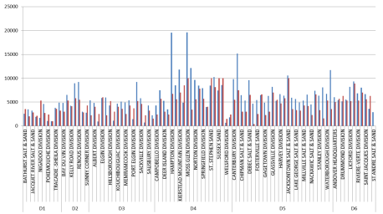
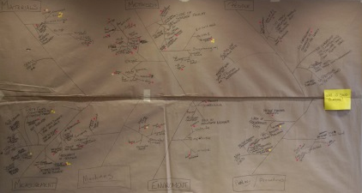
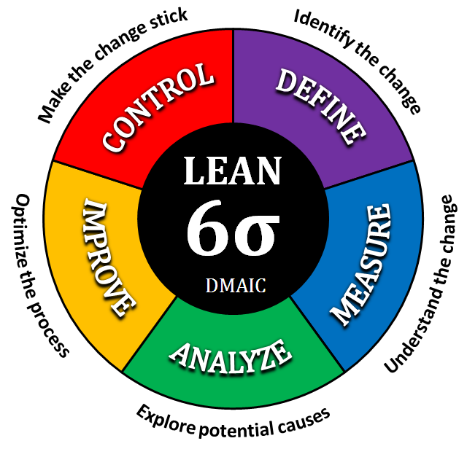
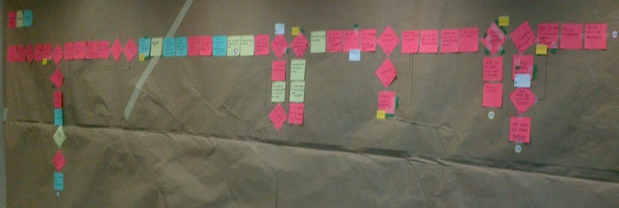
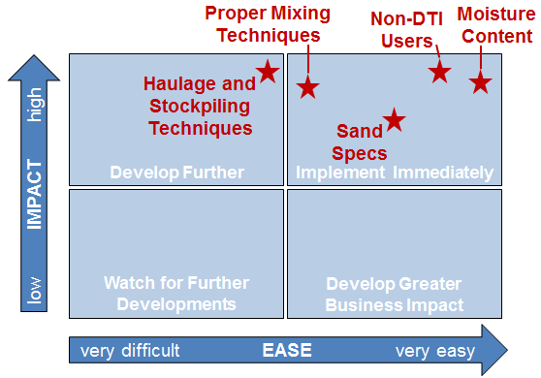
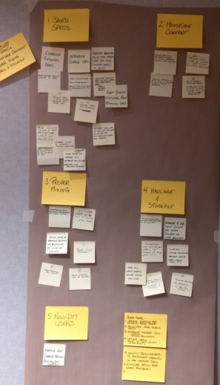
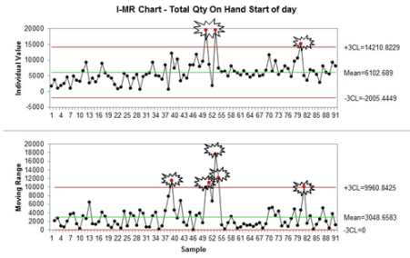
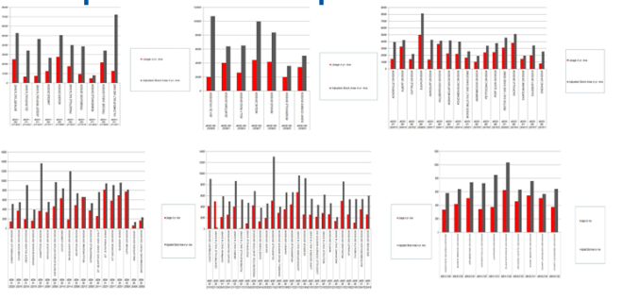
Lean Six Sigma Methodology

Slide 7
True Cost of Sand
 | Cost / t
Average tendered cost of sand (2014/15) | $5
Hauling, equipment rental, manipulating, etc. | $11
Total * | $16
* Does not include additional costs for fuel, maintenance, administration, etc.

Slide 8
Theories to be tested
Sand covered clumps less
Sand with a moisture content > 6-7% clumps more
Stockpile is the optimal size

Slide 9
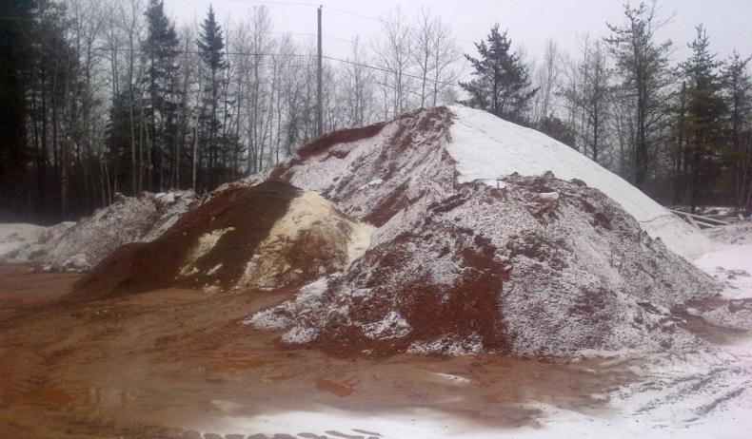
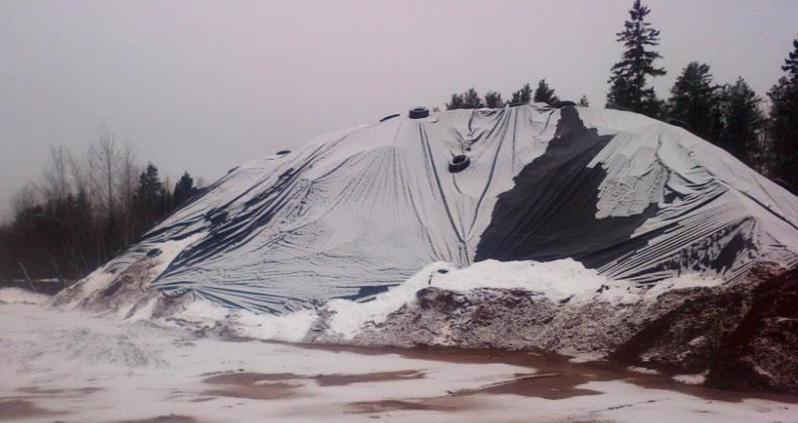
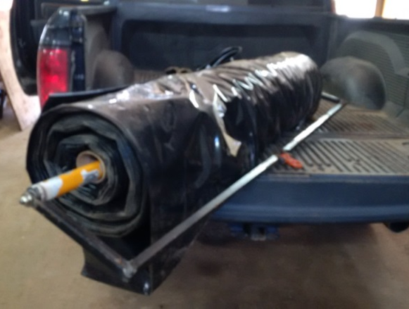
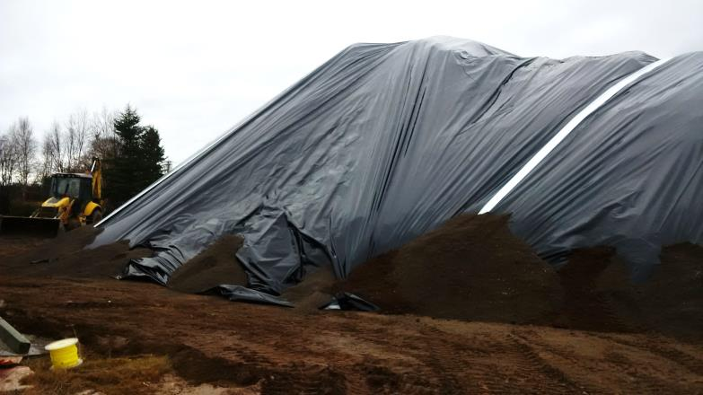
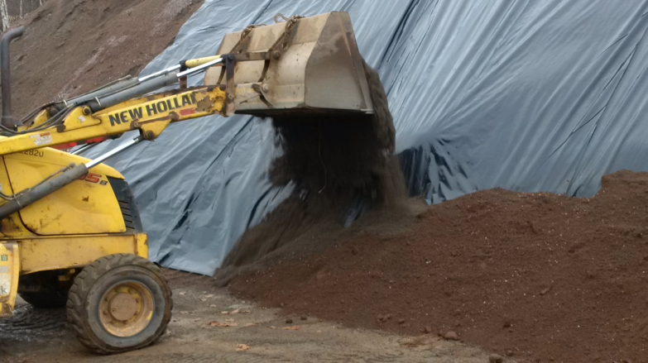
Pilot
VS.
4 sites
Screened natural pit & crusher winter sand
Weekly inspection and reporting
Notes:
Selected 4 sites to conduct pilot project (District 3)
Petitcodiac depot – Screened natural pit winter sand
Riverside Albert – Screened crusher winter sand
Indian Mountain depot – Screened crusher winter sand
Parkindale depot – Screened natural pit winter sand

Slide 10
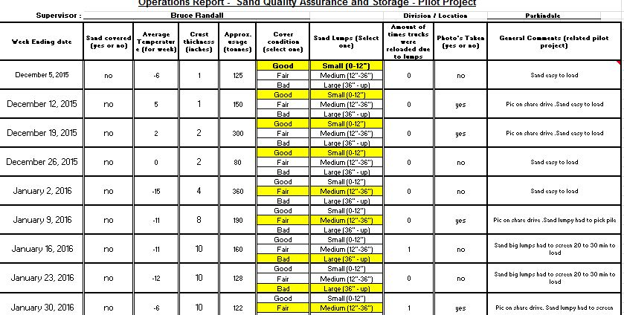
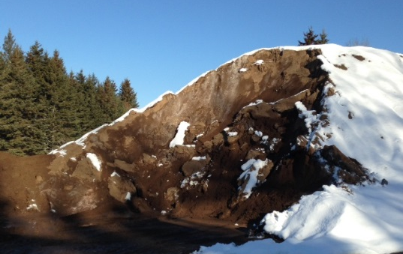
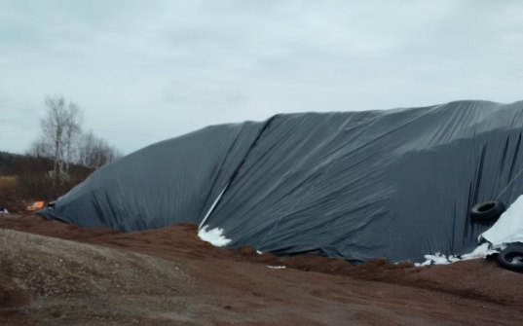
Sand covered clumps less?
SAMPLE
YES
NO

Slide 11
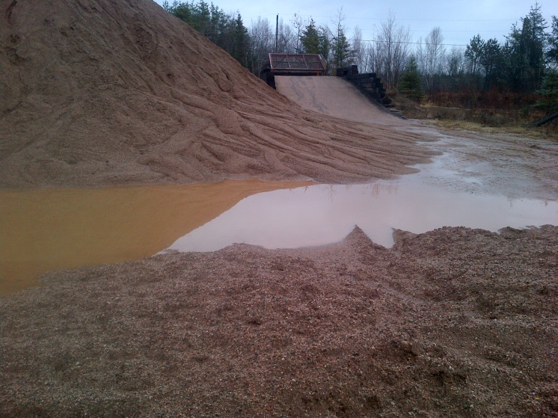
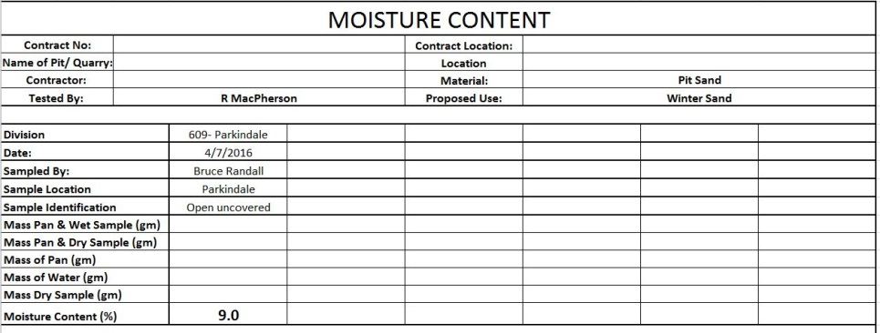
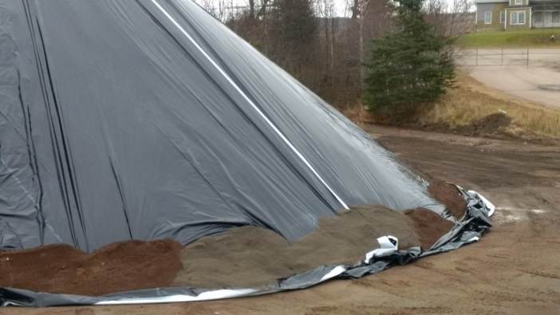
Sand with a moisture content > 6-7% clumps more?
SAMPLE
YES
NO

Slide 12
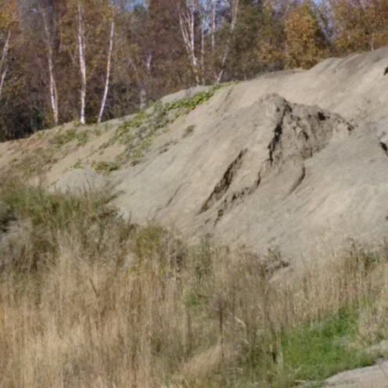
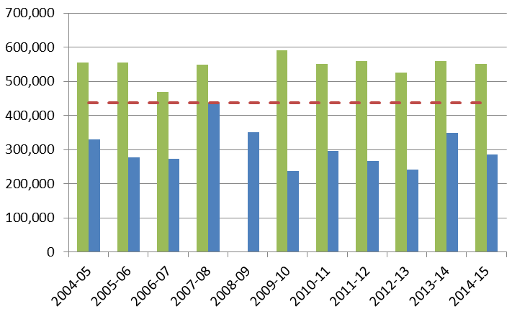
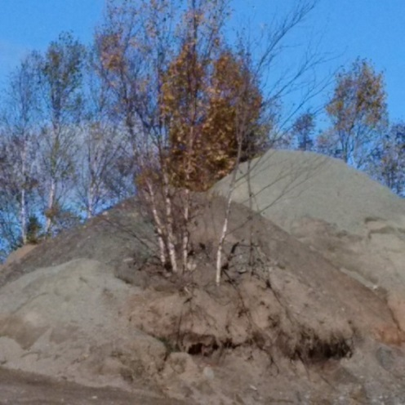
Optimal Stockpile Size
XX t excess sand = X years worth
MAX
YES
NO
140,000t
excess

Slide 13
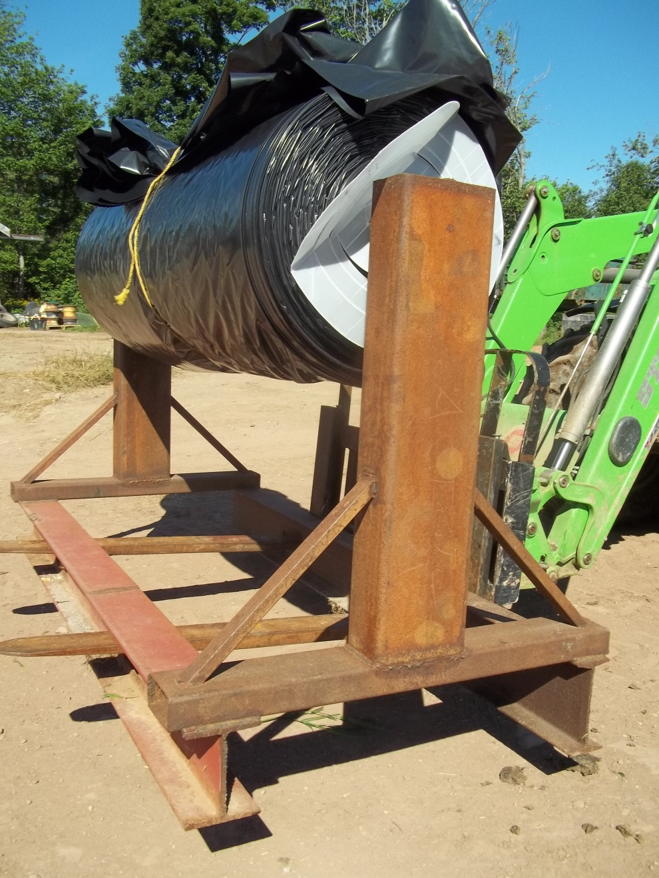
Full Implementation
Training
Video
Covering
Procedures
Increased
Communication
Covering 33 sites = $31,800
2 Unrolling Devices $3,000 (one-time)
Plastic Covering $4,800 / roll (annually)

Slide 14
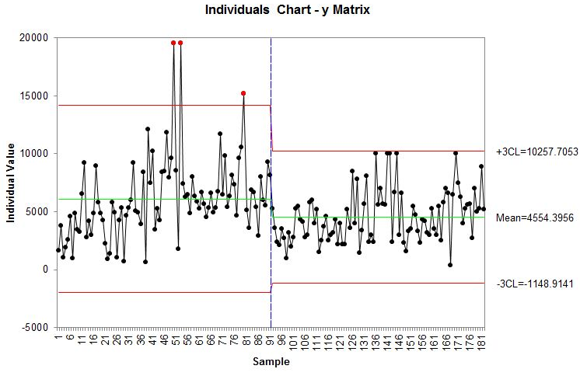
2016/17 Savings
-50,000t
$823,033
Before
After

Slide 15
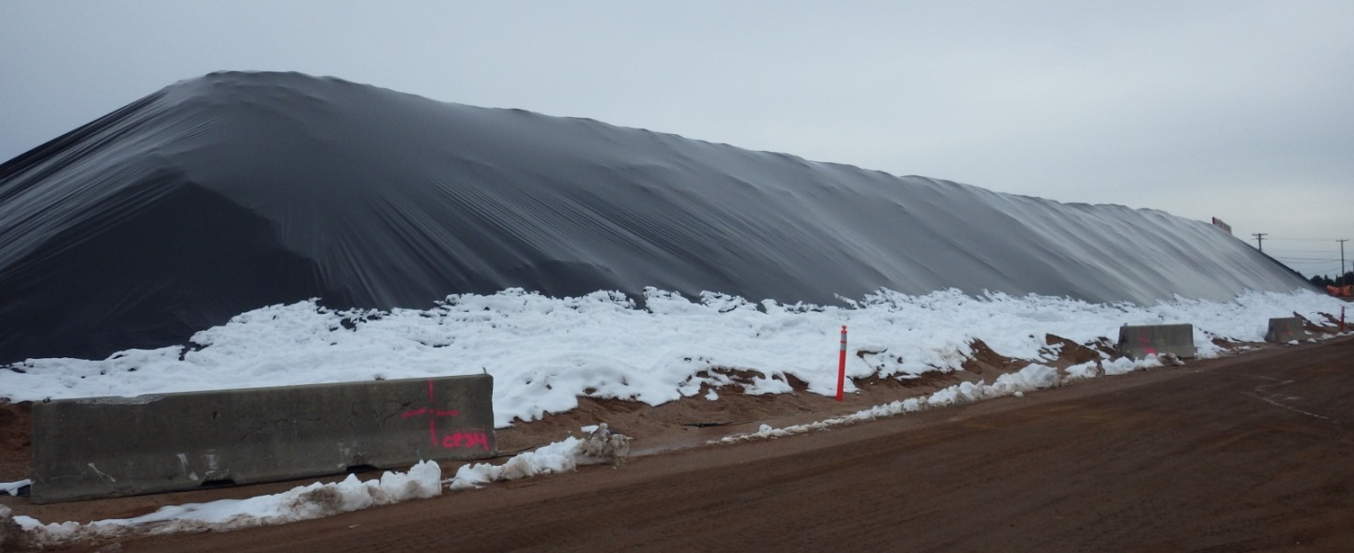
Benefits
Appropriately sized inventory
Reduced moisture content
Contributes towards 2019 national target for covering treated abrasives (75% covered)
Notes:
Appropriately sized inventory
Reduced moisture content
Performance Indicators and National Targets for the Code of Practice for the Environmental Management of Road Salts in Canada
http://www.ec.gc.ca/lcpe-cepa/default.asp?lang=En&n=8D48A850-1
To ensure that all road organizations in Canada have committed to managing their material storage facilities and to ensure best practices at point sources. Case studies have illustrated an elevation in the quantity of salt leached through uncovered piles of abrasives. 2019 Target = 75%

Slide 16
Feedback
“Covering our sand was easy … The crew thinks it makes a big difference.” D4 Highway Supervisor
“This will be our 2nd yr covering sand and we won’t be going back to open piles of sand again” D3 Highway Supervisor
“We should have been using this before, what a difference in sand” D3 Division Staff

