Slide 1

Sanitation Services Review
04/27/2017

Slide 2
Problem Statement
Should the City of Moncton be in the Waste Collection Business??
Notes:
The problem statement isn’t traditional. It wasn’t something we knew for certain was an issue that needed improvement. It was driven out of concern for our employees and their health. In addition it serves as the entry point for our casual workforce into the overall City Permanent Labour force. We aimed to look at the entire service and whether we should even be in it, and if so how it should fit with our labour pool strategy. It was the City’s old school “service review” type of philosophy fit into the Lean Six Sigma model and methodology.

Slide 3
S
I
I (CR)
P
O
O (CR)
C
Need to Pick Garbage
Decide on Carrier /Method
Plan/Negotiate Schedule
Mitigate Risk to Schedule
Pick Garbage
Drop at Waste Site
Compensate for work and Injury
Notes:
We dropped the high-level steps of the overall process into a SIPOC to start and get a clear picture of what elements could/would change and narrowed focus on those right away:
Choosing “Carrier method” process. Ie do we do this service ourselves, or should we incorporate 3rd party contractors
How we compensate…paying the contractor or the employee…which has additional downstream costs..injury time, compensation WCB implications

Slide 4
S
I
I (CR)
P
O
O (CR)
C
Need to Pick Garbage
Decide on Carrier /Method
Plan/Negotiate Schedule
Mitigate Risk to Schedule
Pick Garbage
Drop at Waste Site
Compensate for work and Injury
Notes:
We dropped the high-level steps of the overall process into a SIPOC to start and get a clear picture of what elements could/would change and narrowed focus on those right away:
Choosing “Carrier method” process. Ie do we do this service ourselves, or should we incorporate 3rd party contractors
How we compensate…paying the contractor or the employee…which has additional downstream costs..injury time, compensation WCB implications

Slide 5


Cost of Poor Quality
Notes:
Worksafe NB emphasis on the danger of the job of picking garbage..injury, and death rates on the job. Our cost of poor quality was analyzed and agreed in terms of danger.

Slide 6
Cost of Poor Quality
Lost Time
Worker Quality
Workers’ Comp $
Notes:
Worksafe NB emphasis on the danger of the job of picking garbage..injury, and death rates on the job. Our cost of poor quality was analyzed and agreed in terms of danger.

Slide 7
Cost of Poor Quality
29% of Lost time days can be linked to sanitation employees directly or indirectly over the past 8 years, despite representing less than 1% of the total labour pool.
Lost Time
Worker Quality
Workers’ Comp $
Notes:
Worksafe NB emphasis on the danger of the job of picking garbage..injury, and death rates on the job. Our cost of poor quality was analyzed and agreed in terms of danger.

Slide 8
Analyze Phase – Summary
Notes:
#1 Talk to $60/household standard…we were competitive with industry

Slide 9
Analyze Phase – Summary
Notes:
#1 Talk to $60/household standard…we were competitive with industry

Slide 10
Analyze Phase: FMEA Risk Comparison
Fully Contracted
47 pts
Notes:
There is 10 times more risk in taking on the service ourselves vs contracting. The analysis incorporates risk of service not being performed, injuries to employees and costs associated with overall service components.

Slide 11
Analyze Phase: FMEA Risk Comparison
Current State
542.5 pts
Notes:
There is 10 times more risk in taking on the service ourselves vs contracting. The analysis incorporates risk of service not being performed, injuries to employees and costs associated with overall service components.

Slide 12
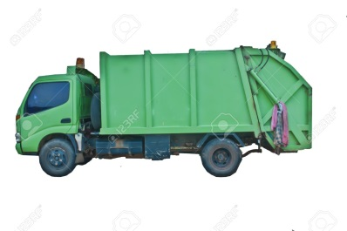
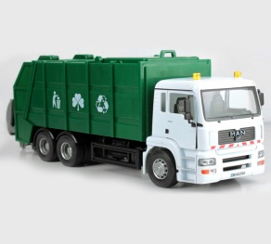
Analyze Phase
Keep
Contract
Direct Control
Risk of Injured Employees
Associated Costs
Risk of employee Injury mitigated
Best Practices Learning Opportunity
Benchmark for Service Delivery (competition)

Slide 13
Analyze Phase: FMEA Risk Comparison
Hybrid: Contract 1 or more zone
411.5 pts
Notes:
There is 10 times more risk in taking on the service ourselves vs contracting. The analysis incorporates risk of service not being performed, injuries to employees and costs associated with overall service components.

Slide 14
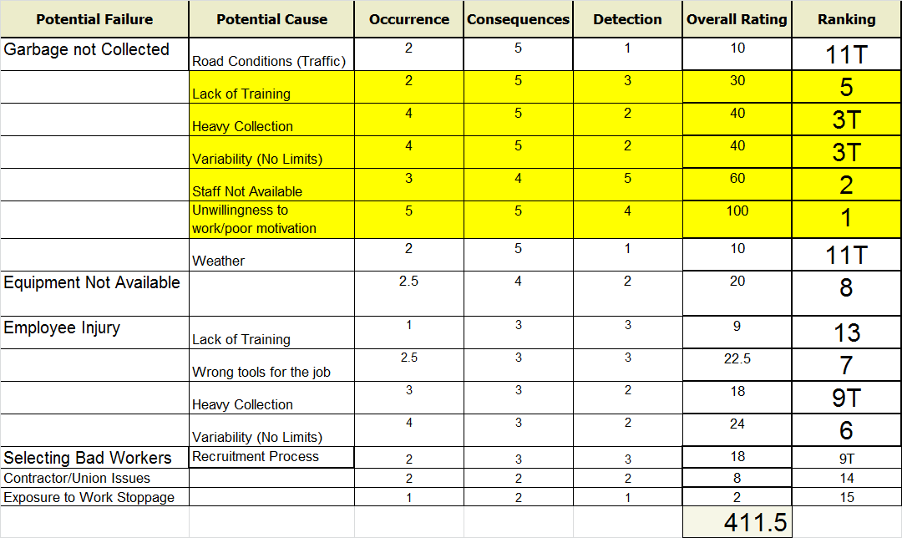
Prepare FMEA and Assess current Control Plans
Areas to focus mitigation efforts, on service zones the City keeps.
Current model drives a score of 542.5, and full contract model is 47.0 – Indicating the more that is contracted, the less risk/exposure to the City.
Notes:
We looked at the Hybrid FMEA again and set out a plan for the next year+ to mitigate remaining risks.

Slide 15



Implementation Plan: Mitigation Efforts
Benchmark Best Practises in other Municipalities
Research Training and Injury avoidance
Explore Hiring and Labour Pool Strategy

Slide 16
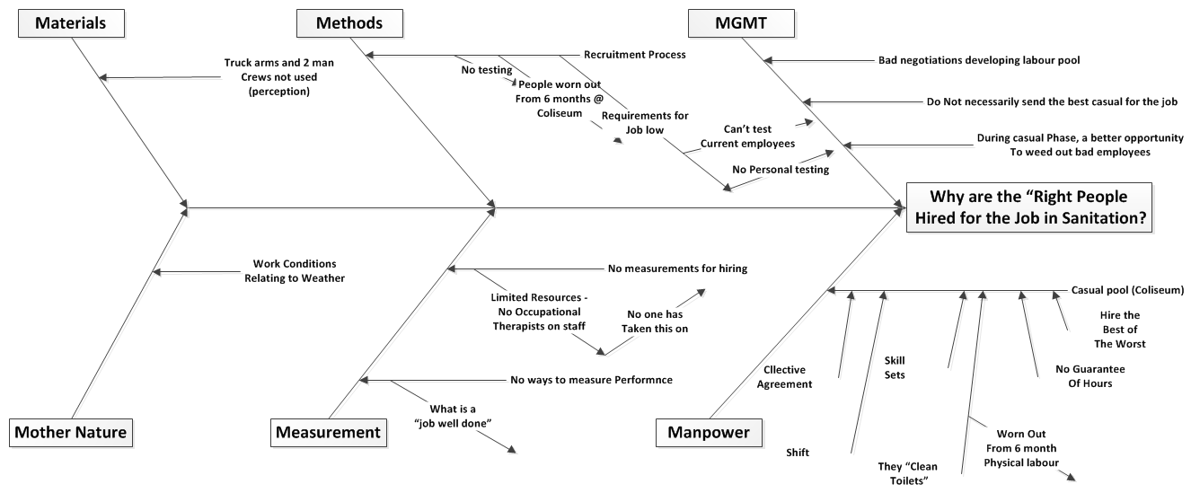
Identify Variables that affect the Process Output – The Recruiting Process
Cause Effect Diagram
Notes:
There was a perception that perhaps the “Right people were not being hired for the job”. We decided to take that anecdote and fishbone it, driving down to what the actual root cause was. Guess what? Not a people problem, it was a process problem, and now we are working with HR on a spin-off project to analyze the role garbage plays in our workforce strategy and how we as an organization ensure that the people are physically capable and have adequate training before doing this job.

Slide 17
Identify Variables that affect the Process Output – The Recruiting Process
Cause Effect Diagram
Notes:
There was a perception that perhaps the “Right people were not being hired for the job”. We decided to take that anecdote and fishbone it, driving down to what the actual root cause was. Guess what? Not a people problem, it was a process problem, and now we are working with HR on a spin-off project to analyze the role garbage plays in our workforce strategy and how we as an organization ensure that the people are physically capable and have adequate training before doing this job.

Slide 18
Solution: Implementation and Control
2016
2017
2018
Q4 -Jan
Mar- May
Q4
May
Prepare Tender
Evaluate/
Award
Benchmark and analyze work practises, equipment and spin-off projects.
Analyze Perform.
Notes:
We went to tender of 1 of our 7 zones in March. We are evaluating the bids now…they were aggressive and we will save money, money we weren’t counting on. In addition, and more importantly, we are going to save on harm to our employees, risk to our service levels and will hopefully benefit from the introduction of ‘competition’ into our service base.
This is done without decreasing our labour force. The additional workers no longer needed will move to other areas that need more manpower and hopefully improve their efficiency.

Slide 19
Lessons Learned
Should have been a sanitation worker involved in the project (VOC)
Met tight timeline (mostly done in Nov)

Slide 20
Lessons Learned
A lot of research already done
Right people in the room
Open mind from operations

