Slide 1
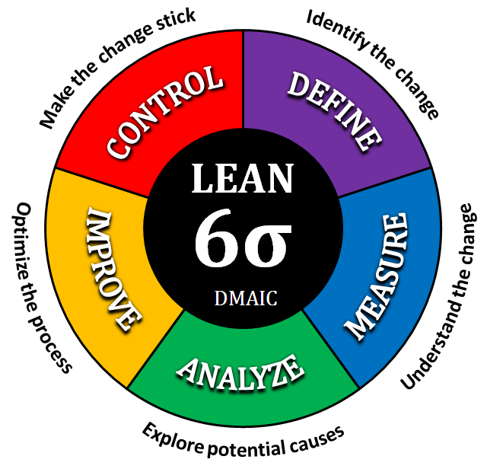
Dept. of Energy and Resource Development
Licence of Occupation Application Process (Cycle Time)
Stephanie Elkins

Slide 2

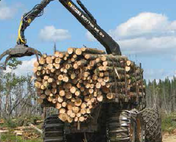
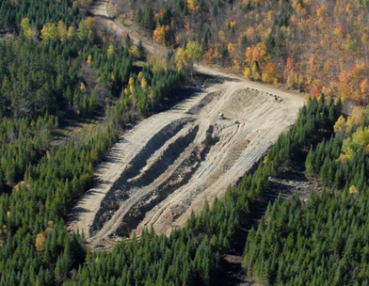
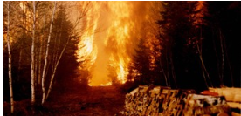
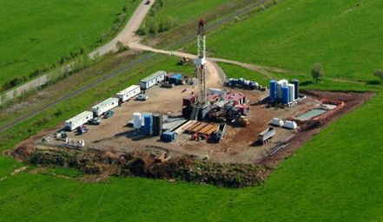
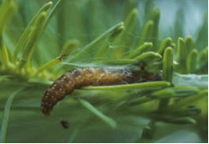
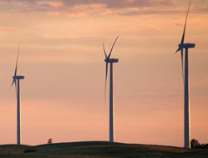

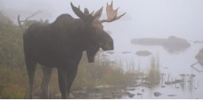
Energy and Resource Development

Slide 3
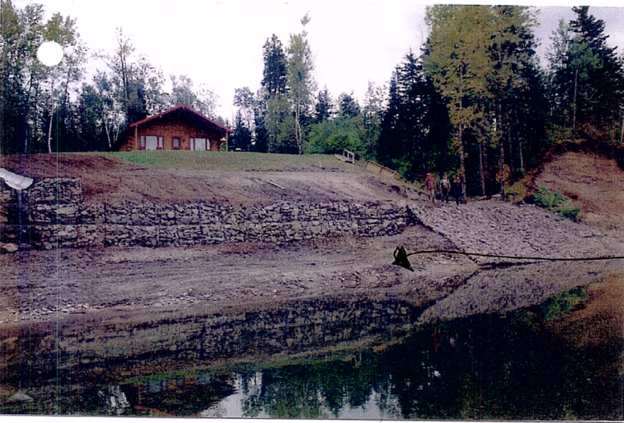
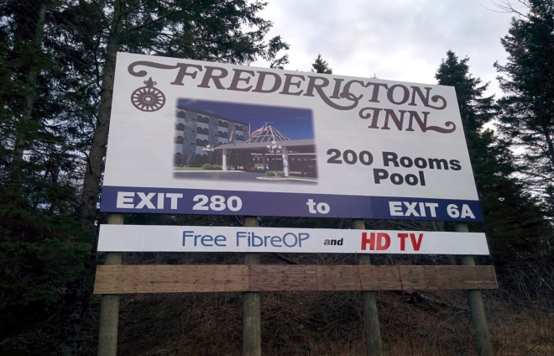
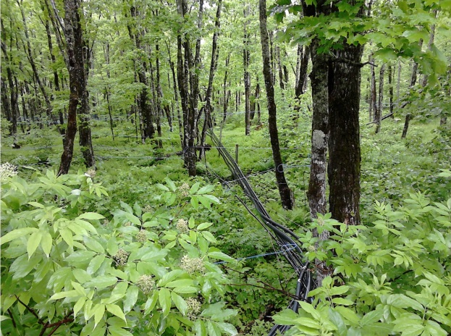
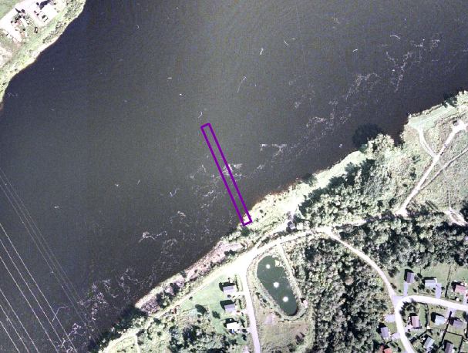
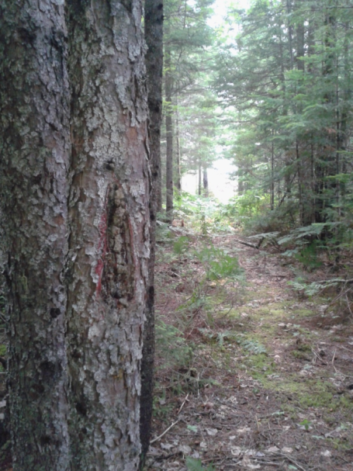
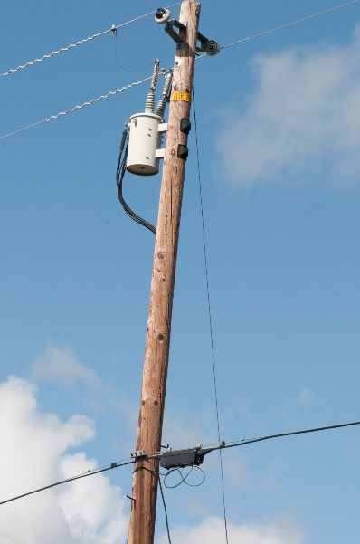
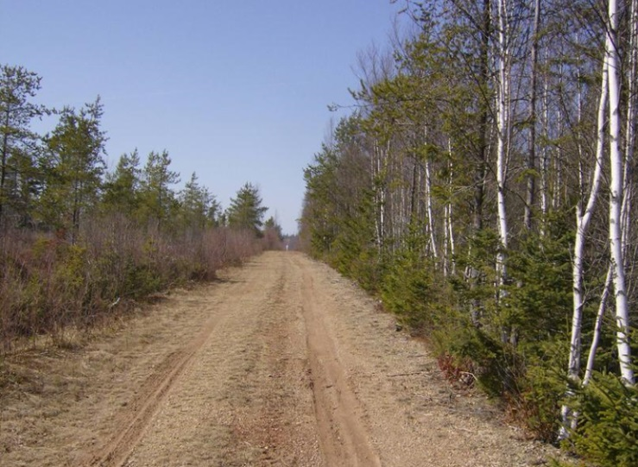
Licence of Occupation

Slide 4

Define Phase
Problem 114.9 days
Goal 87 days, 80%

Slide 5

Define Phase

Slide 6
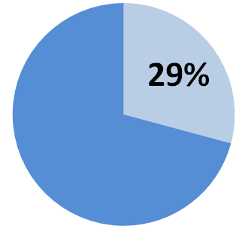
Define Phase

Slide 7
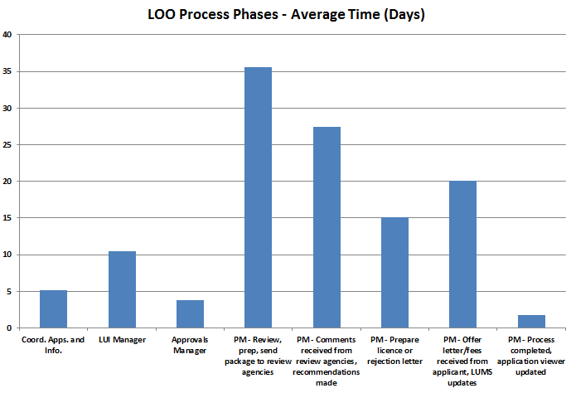
Define Phase
?

Slide 8
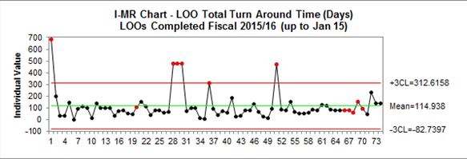
Define Phase
Process out of Control!
IMR Chart – Licence of Occupation Cycle Time (Days)

Slide 9
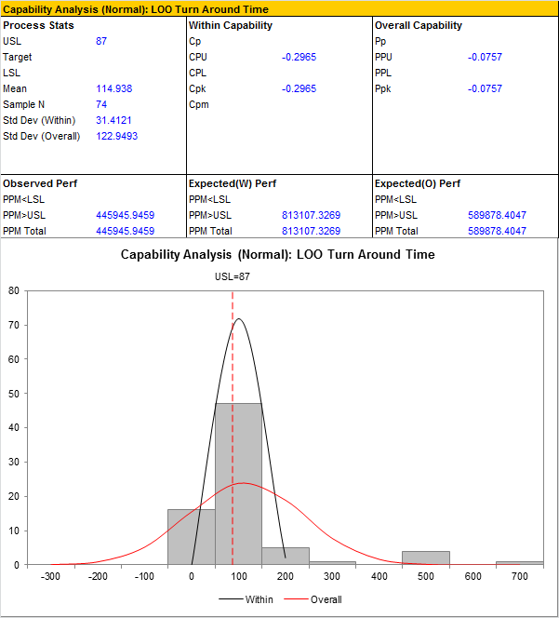
Define Phase
59% above target!

Slide 10
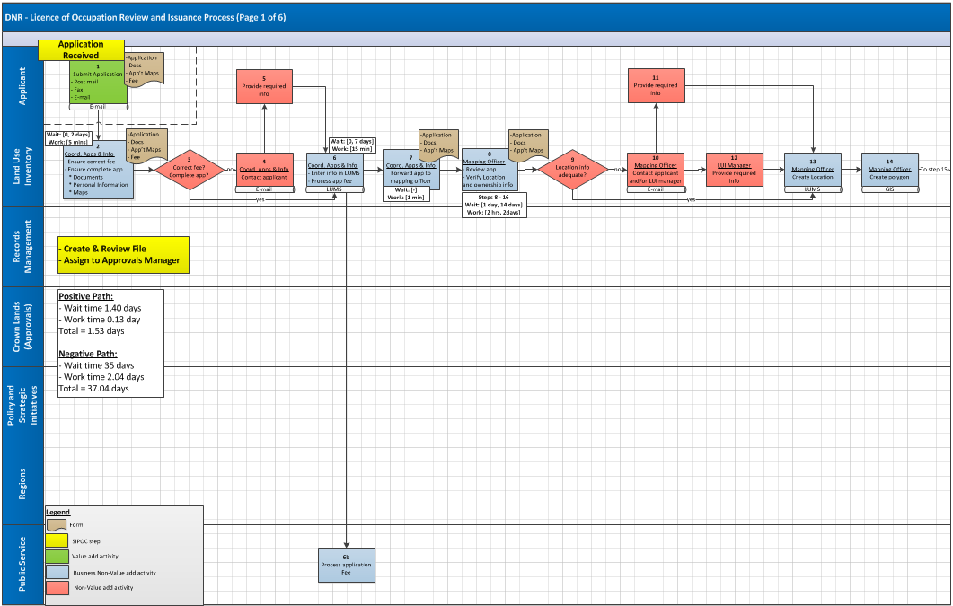


Measure Phase

Slide 11
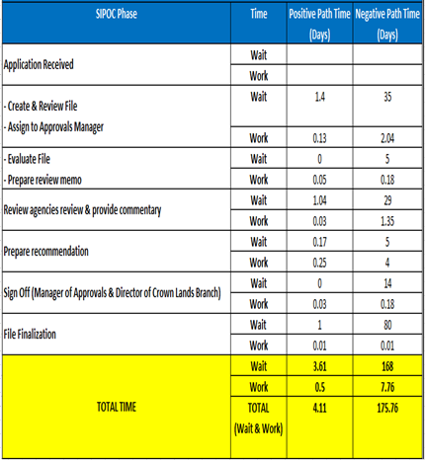
Measure Phase
88% to 96% waiting!!!

Slide 12

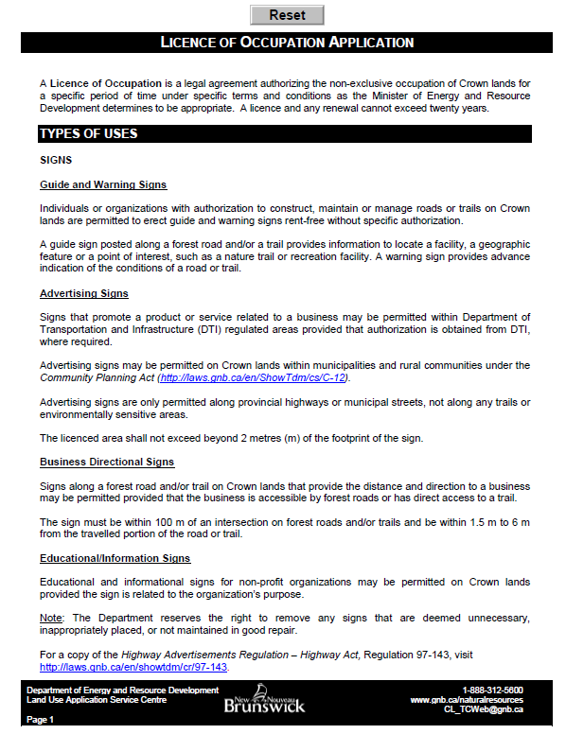

Review Agencies
Analyze Phase
Application Type
Project Managers

Slide 13

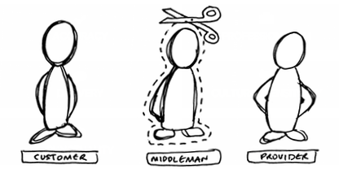


Review Agencies
Improve Phase
Application Type
Notes:
In house solutions using existing software
Removing the middle man
In some instances no Director’s signature
Discussions initiated with some high frequency internal GNB customers

Slide 14
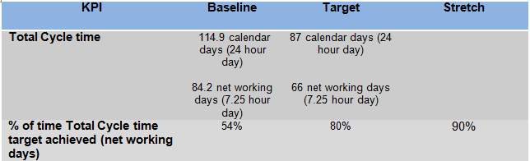
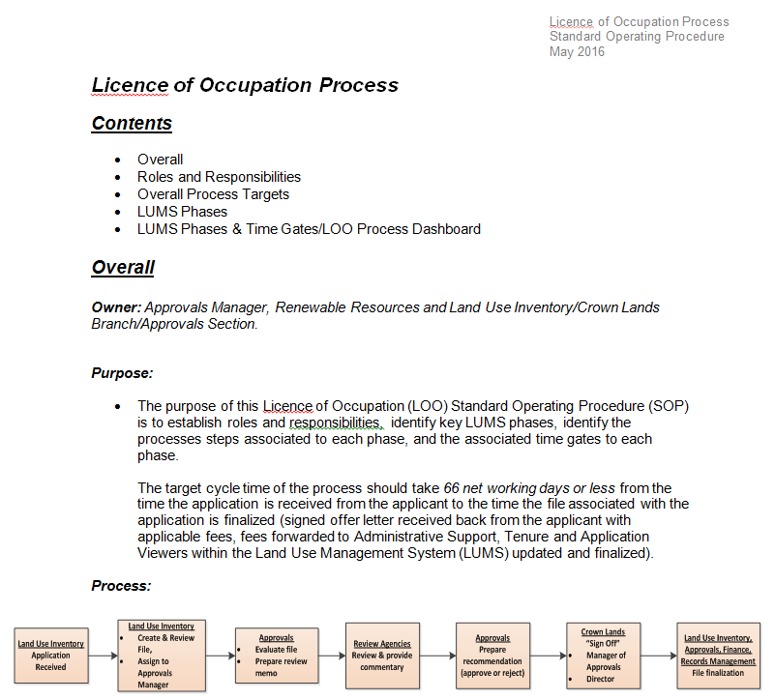
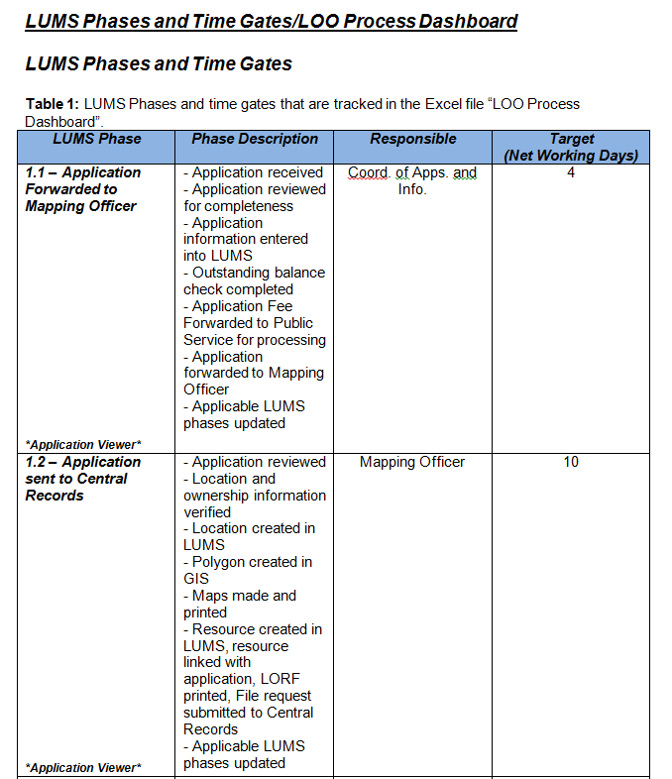
Project Managers
Improve Phase
SOP
Overall process targets
Roles & Responsibilities
Time gates

Slide 15
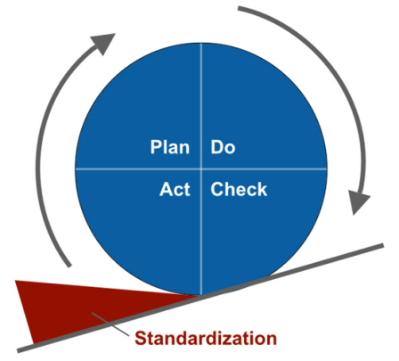
Daily Management
Improve Phase

Slide 16
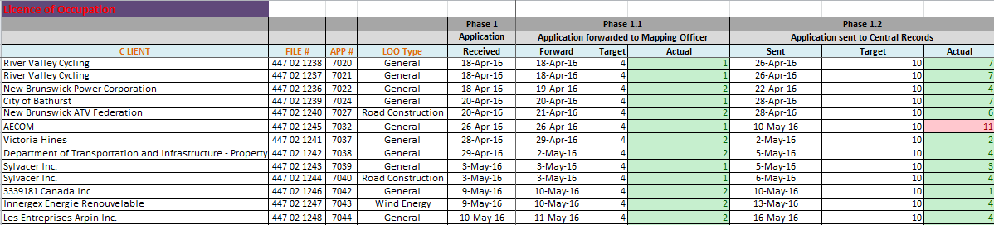
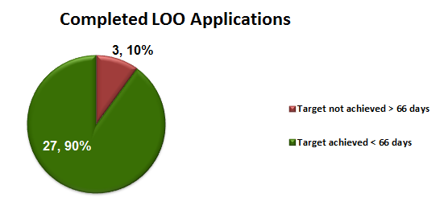
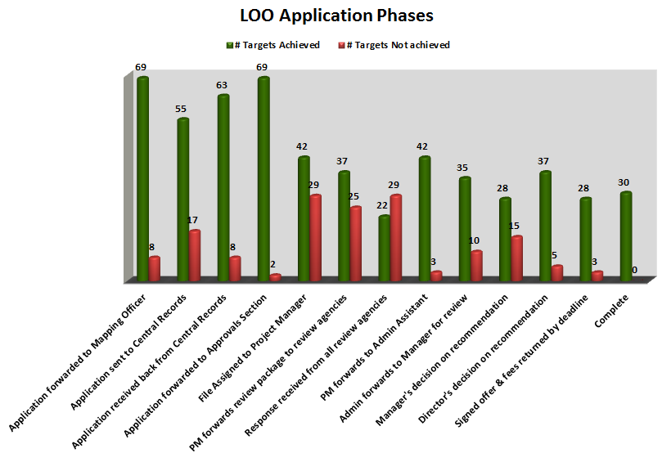
Improve Phase

Slide 17
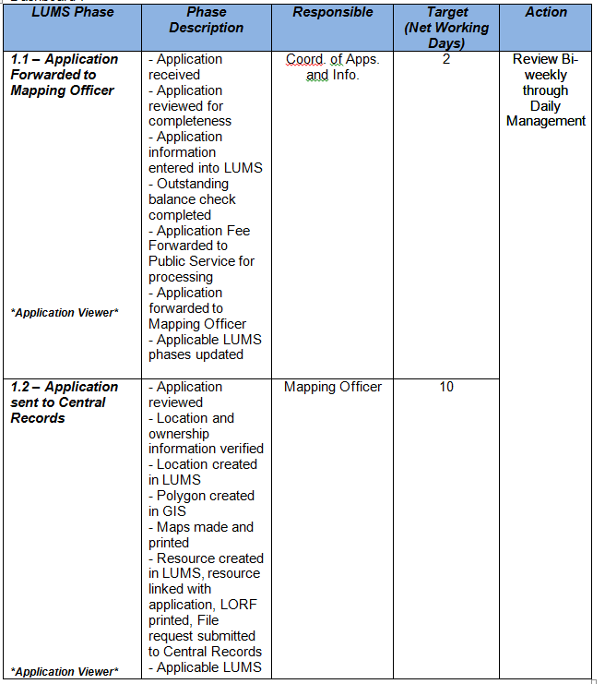
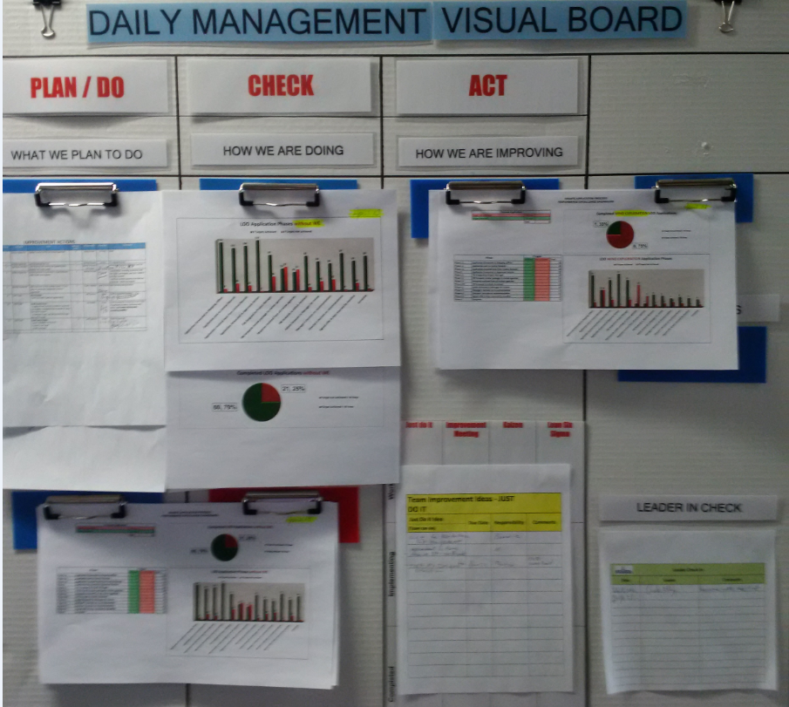
Control Phase

Slide 18
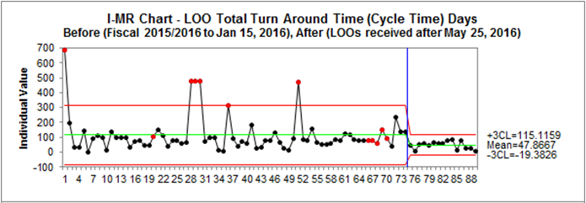
Control Phase
Process in Control & Capable!
IMR Chart – Licence of Occupation Cycle Time (Days)
(Before and After Process Control)
Notes:
58% improvement

Slide 19



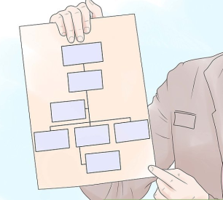

Data is crucial!
Standard operating procedures are key!
Monitor, measure, & accountability!

Slide 20
Thank You!
Questions?

