Slide 1
Investing in your people to Drive Productivity
Speaker: Lori Schmidt
GO Productivity
www.goproductivity.ca
Notes:
Our thanks to our conference Co-chairs, Chris (MacPherson) and Nina (McCarthy) for their vision and leadership of this conference – and for the opportunity to be able share some of work and learning around the topic of productivity and our people.
GO Productivity is not for profit organization supporting SME’s including small-medium construction firms learn to grow and optimize.
we help SME’s become productivity experts, we help them to learn how to improve performance with better utilization of their people and resources
So today we will explore an introduction into the topic of productivity and dig down to the key factors that can predict and improve your organization’s performance and productivity – and that is – investment in your people

Slide 2
Our discussion today
GO Productivity
What is Productivity and how do we measure it? – pitfalls of previous models
Resourcefulness – people our most valuable resource
Drivers of Competitiveness Hierarchy – what REALLY drives productivity???
Lagging Indicators
Leading Indicators
Intentional about your Innovation
How do you measure / quantify the investment in people?
Case study – here’s the impact.
www.goproductivity.ca
Notes:
What I would like to review in this session is
A little bit about GO Productivity….

Slide 3
GO Productivity…
…makes small ideas equal huge impact
…comes from supplies, customers & employees
Innovation
Leadership
Strategy
…brings in team, leaders & the community
Collaboration
Operations
…supports continuous improvement
…must be built into strategy as a well managed system
© GO Productivity
www.goproductivity.ca
Notes:
We began as Productivity Alberta were founded in 2008 as a service of the Government of Alberta to help the province’s small-to medium-sized enterprises be more productive, more competitive and more profitable.
In October 2011, Productivity Alberta grew into GO Productivity - a private, national not-for-profit corporation.
We are Industry Board-led. We exist to guide and strive towards operational excellence; developing a culture of innovation; and building leaders for the future success of our small and medium-sized businesses

Slide 4
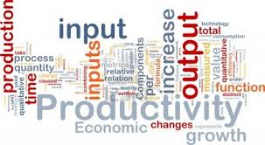
What is Productivity?
Productivity = Output / Input
Output can be:
Products Sold
Tasks Completed
Tonnes of steel erected
Input can be:
Person-Hours
$ Dollars
Time
International measures look at Output per Employee
www.goproductivity.ca
Notes:
Productivity is a commonly used word today, but lets start with its truest definition, a simple formula!
Essentially – productivity equals output for the level of input
Output can be – products sold, tasks completed, tonnes of steel erected
Input can be person hours, dollars or time
International measures look at the output per employee

Slide 5
Productivity Definitions
Level 1: Little ‘p’ Productivity: productivity = output / input at the individual level (ex: tonnes of steel erected / person-hour or action requests / person hour)
Level 2: Big ‘P’ Productivity at the system level ; is the company’s or division’s or a branch’s output at an acceptable level compared to others? Equivalent to measuring competitiveness
www.goproductivity.ca
Notes:
How do we use the productivity formula? Lets start with two general levels and an example
We often look at the Federal Government Labour Productivity Index:
Labour Productivity = GDP / total hours worked

Slide 6
How Productivity Affects the Nation
GDP per Capita (Prosperity)
Labour*
Productivity
Population
Utilization
Intensity
Sources of Productivity Growth
Find New Value
Efficiency / Optimize
Drivers of Productivity Growth
Skilled Workers and Management
Innovation
Science & Engineering Talent
Capital Investment
Business & Policy Environment
Foreign Trade
Competition
*Definitions
Population: proportion of the population who are of working age and available to contribute to the production of goods and services
Utilization: employment among the working age population
Intensity: hours per worker, or total hours worked by the engaged working age population
Source: Path to the 2020 Prosperity Agenda - Task Force on Competitiveness, Productivity and Economic Progress
© GO Productivity
Notes:
This productivity framework breaks down the components of productivity in a more meaningful way. Our prosperity (measured by GDP/Capita) equals our labour effort – times - our productivity. So – more simply put – to increase productivity – you can either increase your labour effort – and Canada has done quite well on the labour side at this point – or you can increase productivity.
Sources of productivity growth come from either adding value in the products, processes, or services we provide - or through efficiency gains through productivity enhancement. We need to focus on both of these aspects.
Further – the drivers of productivity are boiled down to these 7 main areas: skilled workers and strong management capability; scientific and engineering talent; innovation; investment in capital - including; investment in information, communication and technology systems and in automation through machinery and equipment; - and other drivers are competition; business and policy environment - and trade.

Slide 7
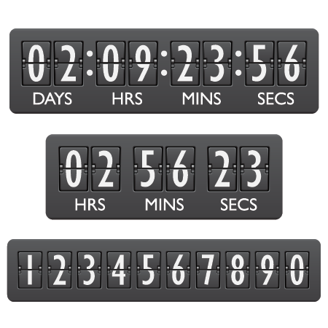
Productivity = Resourcefulness
Productivity at the firm level:
- about unleashing the potential of people, $ resources, and time
About working SMARTER –
not harder
www.goproductivity.ca
Notes:
People are our most valuable resource

Slide 8
Talent Mismatch – Investing in our People to be Competitive
Canada has 1.32 million unemployed and 400,000 unfilled jobs
People without jobs and jobs without people
Global Talent Index – 200 million people unemployed world wide despite over 33 million people looking for work in Europe and the USA.
Those organizations that invest in workforce capabilities and who measure and value workforce competency will be the winners.
www.goproductivity.ca
Notes:
Canada has a reluctance of business to effectively invest in our people - workforce training – it is holding us back. The more critical issue is ensure the training is well directed. So many of our training and skills investment is not in areas that support he changing economy needs or empower innovation.

Slide 9
Drivers of Productivity Hierarchy
Cart
Leadership and Management
Cultural Alignment
Human Capital, Innovation & Collaboration
Knowledge, Skills and Abilities, Interactions and Collisions
Economic Competitiveness
Growth and Job Creation
Capital Investment
Automation and R & D
Operational Excellence
Process Optimization
Lagging Indicators
(Results)
Leading Indicators
(Drivers)
Horse
www.goproductivity.ca
Notes:
Lets look further into what the people part of the equation means to productivity, which ultimately leads to competitiveness
*This is a relatively new field of research: Looking at pairing Maslow’s Hierarchy of Needs with Business Productivity Theory
As government we tend to focus on the lagging indicators – and we need to look more at what are the inputs leading indicators to get us there.
The premise is that by investing in human capital – your people, it will lead to stronger leadership and management performance - …….
*There is also complexity around how to measure human capital, but it is easy to start measuring within your own company and benchmark against yourself
And in the side column you will see some samples of what can be measured at each level …….

Slide 10
www.goproductivity.ca

Slide 11
Lagging Indicators – Competitiveness/Productivity
Lagging Indicators: (effects)
Number of new jobs created
Number of new markets entered
Overall sales increases
Investment in capital equipment
Limitations:
Lagging indicators can predict future trends
But no opportunity to change results they measured – can’t change the past
‘broad outcome’s - hard to pinpoint what actually caused the improvement in number of jobs, new markets etc.
New markets; potentially good but also potentially mistaken choices that lead to great losses
www.goproductivity.ca
Notes:
Lets start with Lagging indicators -
Historically, the government collects this data to find out how well the economy is performing. They measure the number of new jobs, new markets and overall sales increases – or capital investment.
There are some issues with measuring in this way:
*here is a simple story to help understand this better:
It often can take a company a year of discernment before they realize there is an opportunity to streamline their processes. (Lean journey) They make the process changes, celebrate the win and communicate to their clients they can do it better and faster. But they didn’t hire anyone new and didn’t enter into any new markets. Eventually once the customers catch on this company can perform better and faster they start buying more. So eventually the sales will go up, and eventually in a couple years the company will grow and hire more people. So when the productivity improvement occurs it takes a couple years before these measures show there was anything happening.

Slide 12
Leading Indicators – Competitiveness/Productivity
Leading Indicators: (causes)
Investment in Research and Development
Innovation (Ideas generated / implemented)
Training/collaborative learning
strategy
Limitations:
Improvements to one small process may not have large impact on overall performance of a system
R&D reflects only 20% of innovation
R&D reflects only large investments, small investments with big impacts are usually lost in translation
www.goproductivity.ca
Notes:
If we look at leading indicators – such as investment in research and development or investment in new capital equipment we see what our case study company did to improve
They did some R&D
At the company level: we can anticipate sales growth by looking at if we are investing in training and cultivating/implementing innovative ideas and doing the research to back it up.
A current Metric that uses Leading Indicators:
Global competitiveness ratings (GFCC) include factors such as R&D spending and innovation to gage how productive an entire country/nation is.

Slide 13
Investment in People “Human Capital” as a Leading Indicator
www.goproductivity.ca
Notes:
One of the key elements going into the very beginning of a step up in improvement is…our people.
Lets look into how investing in our people could be the foundational leading indicator

Slide 14
Improving on measuring productivity / competitiveness
There is no ‘silver bullet’ metric
There is value in using various metrics, know when to use them
What story does this metric tell?
Which metric best suits the people who will receive the information?
So then, what comes first?
www.goproductivity.ca
Notes:
In order to get better at measuring productivity, which ultimately is done so we can improve productivity -
We must know the metrics, choose which ones are best and understand the value and limitations of each one and when to implement

Slide 15
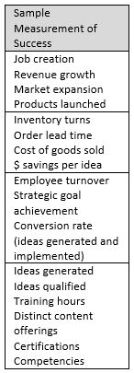
Canadian Industry Hierarchy of Metrics – Based on Maslow’s Hierarchy of Needs + Business Productivity Theory
www.goproductivity.ca
Notes:
If we look again at the drivers of competitiveness – business productivity theory - along with metrics at each level

Slide 16
www.goproductivity.ca
Notes:
*When we think about Productivity and innovation we often first go to Technology and Process Improvements. Often we forget to consider the people-part of innovation – the most important part - ideas.

Slide 17
Innovation is important
"Capital isn't so important in business. Experience isn't so important. You can get both these things.”
“What is important is ideas. If you have ideas, you have the main asset you need, and there isn't any limit to what you can do with your business and your life.“
— Harvey Firestone
Investing in your people – training for creativity and innovation
www.goproductivity.ca

Slide 18
Successful Innovation is Based on Collaboration
“Innovation is the advancement of technologies, ideas, or methods through the introduction of new or improved products or processes.”
“Innovation is two or more people or organizations working collaboratively towards a common goal of advancing new or improved technologies, ideas, or methods.”
“
© GO Productivity
www.goproductivity.ca
Notes:
So when we add the idea of collaboration to innovation, we get a definition that looks like this. We can see an expanded idea of what innovation is, what innovation can be applied to, and that for the organization, innovation creates value.
Innovation is not just big – small non technical – belongs to everyone – like lean – small incremental improvements.
Productivity and its competitiveness is strongly tied to a company’s ability to innovate.

Slide 19
Innovation Goes Beyond New Products and Technologies
Market Extension
Business Models
Re-Invent
Technology Invention
Innovation
Product Improvement/Integration
Process Improvement
System Solutions
www.goproductivity.ca
Notes:
Social Systems means the management actions coupled with the practices, processes, structures and systems created in your organization that enable and sustain a climate of innovation – and yes, any of these can be innovative.
→
Market Extension means either meeting a need in the marketplace where no solutions exist or adapting an existing product for a new market. An example of this is Arm and Hammer Baking Soda. The company extended its use as a baking product to offer it as a refrigerator deodorizer.
→
Business Models means reconfiguring how business is conducted. An example of this might be eBay, although many companies have changed business models to improve profits or make transactions simpler. In the case of eBay, they created an international classifieds website to allow buyers and sellers to come together in a very seamless way by facilitating the entire transaction including transferring the funds from the buyer to the seller. All that is left for the seller to do is to ship the product to the buyer.
→
Process Improvement: Streamlining their business to be more effective, efficient and productive; resulting in work being easier, faster, more accurate and reliable, more integrated, and less expensive. Wal-Mart is a master of supply chain management and inventory control. They vastly improved the way retailers order merchandise and manage their inventories.
→
System Solutions: Rethinking and integrating current systems or generating new systems to solve existing problems within a business or supply chain. FedEx operates its own aircraft, depots, posting stations and delivery vans to ensure overnight delivery of packages.
→
Product Improvement: Improvements to products in ways that allow companies to be more competitive, create new value to the customer, and increase productivity. Xerox, once a copy company expanded their product to include printers, fax machines and all-in-one technologies to help make their customers more efficient.
→
Technology Invention: Product creation and development with a new core technology or new generation breakthroughs. Apple has been a leader in new technology invention with its series of handheld devices and music players. They revolutionized this market.
Ex. Some of these companies have even started to force innovation down their supply chain. McDonald’s forces their suppliers to be energy efficient and the bread suppliers all come together to share their ideas on how to reduce their carbon footprint.
Ex. Walmart hired the CEO of Patagonia to help them with their Environmental Sustainability plan and improve their environmental practices. Patagonia has been a leader in their commitment to environmental initiatives, including recycling used clothing from their line.

Slide 20
Think of some ways you could innovate
Market Extension - Meeting a need in the marketplace where no solutions exist or adapting a product for use in a new market
Business Models - Reconfigure the nature of the business to make it easier to do business, create more integrated products and services, devise better ways to be profitable, or use resources in a new way
Process Improvement - Make processes simpler, faster, more accurate, more reliable, less expensive, or more integrated
Systems Solutions - Rethinking & integrating existing systems or generating new systems to solve existing problems
Product Improvement/Integration - Improvements to products in ways that allow companies to be more competitive, to create new value to the customer or to increase productivity
Technology Invention - Product creation/development with a new core technology or with breakthrough technology
www.goproductivity.ca
Notes:
Discussion Point:
Ask the participants to form groups and choose two kinds of innovation. For each, ask them to think of that their organization could demonstrate this type of innovation. Have them explain how the business could achieve it. (10 minutes)
Ask one person from each group to share their examples.

Slide 21
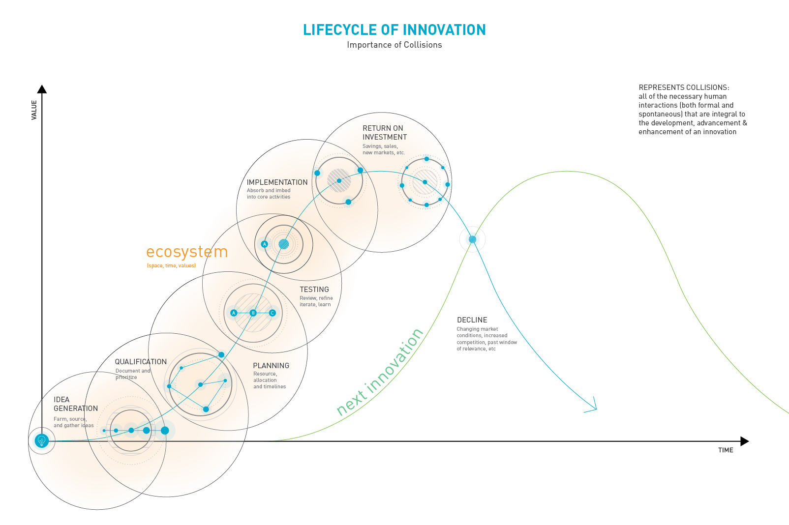
www.goproductivity.ca
Notes:
Collisions – this is the way in which we need our people to work together/ interacting – supporting systems to be able to help move through quickly

Slide 22
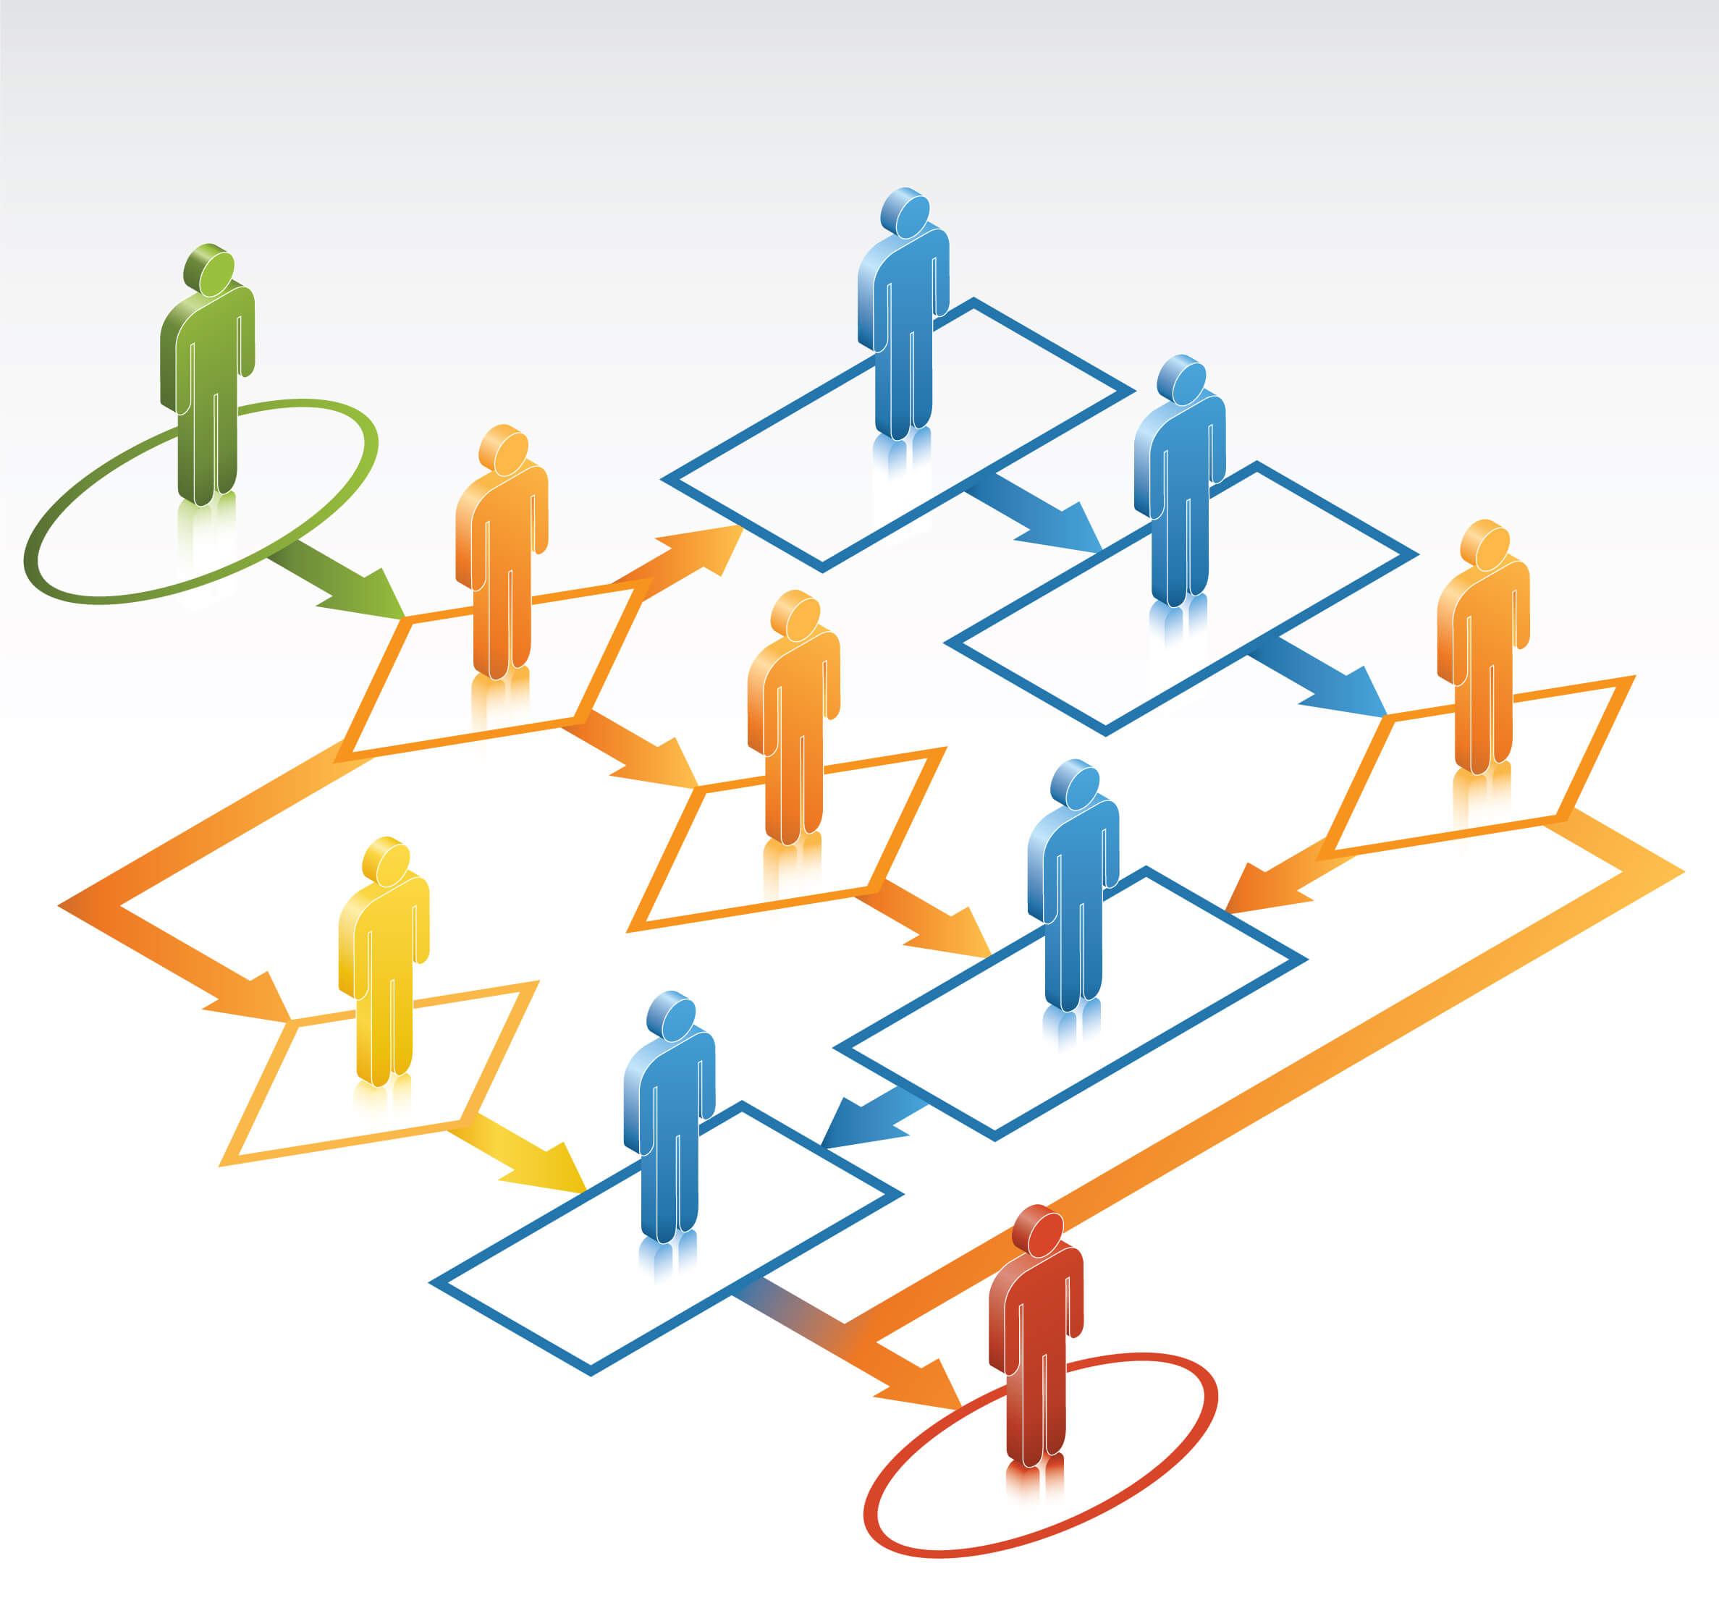
www.goproductivity.ca
Notes:
Systems thinking – design thinking – breaking down the complexity through training building of our people .Now lets look at what happens when we start to invest in our people.
Now lets talk about how we measure the people part of the equation
*There continues to be challenges on how to measure this, when to measure and what to measure - advantages and Disadvantages of doing different ways, so we’ll talk about a couple of these

Slide 23
Why Measure Investment in Your People?
(Human Capital) MEASURE INVESTMENT IN HUMAN CAPITAL
Capturing $ invested in people (human capital) is not an exact science.
However…
It is essential to attempt to capture this investment, as it is a tremendous indicator of future value.
INCREASED WORKFORCE CAPABILITIES & CONTINUOUS IMPROVEMENT CULTURE
www.goproductivity.ca
Notes:
We can get better at accurately measuring – but even a crude measure begins to paint a picture for us
Easy to say I brought a piece of equipment – but even measuring the impact or return on investment of the value the equipment brings to an organization is not always calculated.

Slide 24
How to Measure Investment in Your People (Human Capital)MEASURE INVESTMENT IN HUMAN CAPITAL
CHANGE YOUR PERSPECTIVE
START TRACKING HOURS
CELEBRATE THE INVESTMENT
DEFINE
HCM
APPLY
HCM
Some leaders worry, ‘what If I invest in my employees and they leave’? When they should be wondering, ‘what if I don’t invest in them and they stay’?.
www.goproductivity.ca
Notes:
There are five steps to begin to measure the investment in your people

Slide 25
1. CHANGE YOUR PERSPECTIVE
Employees need time away from their core roles in order to learn and grow, in order to add new and greater value to the organization.
If effectively planned, this time shouldn’t be regarded as time OUT(side) of their jobs, but rather as time IN(vested) into theirs and the companies future growth. This is about long-term gains!
.
Time IN(vested)
leads to…
Productivity gains and
enhanced performance
Higher levels of innovation
www.goproductivity.ca
Notes:
Importance of understanding formal innovation structures – creating a continuous improvement environment
Recognizing what is the “horse” and what is the “cart”. Now thinking more intently about the drivers and leading and lagging indicators

Slide 26
2. START TRACKING HOURS
Problem Solving
Keep metrics around all of the time spent in internal & external training, learning, and collaborative problem solving. As a management team, qualify which exercises apply.
Innovation Committees
Collaborative Learning
Business Improvement Initiatives
Training
Ex/. Arbitrary hours tracked over 6 months (among 15 employees) = 300 hours
www.goproductivity.ca
Notes:
Hours invested in productivity assessments
Hours of productivity coaching
Hours invested in productivity / lean training
Hours invested in development of formal innovation structures
Hours invested in continuous improvement initiatives
We don’t generally track these.
Example - First know the amount of hours

Slide 27
3. DEFINE HCM (Human Capital Multiplier)
Employee value per hour
Examine your cost and revenue structure and establish a general value of each hour on an employee’s time. This is your HCM. The HCM can incorporate the total employee cost (salary, benefits, etc.) and the opportunity cost (what is the cost to the business for not investing in this employee’s future?)
Salary, benefits, etc.
Opportunity cost
Ex/. Arbitrary HCM = $80/hour
www.goproductivity.ca
Notes:
Once we have total hours – we need a definition of a human capital multiplier – what is the worth or value of each hour. Depends on the organization – could vary – could be a scale depending on how long the employee has been with you – should factor in total employee cost. Also consider the opportunities cost – what is your cost by not investing in the employees future. Not an exact science – but a starting point. Lets say - An average employee – value of each employee – example is $80 Why it is important – we can start to look at the value of each our hour.

Slide 28
4. APPLY HCM
To apply the HCM, we need to multiply it with the number of tracked hours invested in human capital over a certain period, which allows us to obtain an approximate financial investment ($) for that period.
Innovation
Increased Performance
Overall Growth
Ex/. $80/hour x 300 hours = $24,000 (this represents investment in human capital over 6 months)
www.goproductivity.ca
Notes:
Now we apply the HCM (human capital multiplier – each value is calculated for 6 months – total investment in human capital. Might not be perfect – but starts to recognize the importance of the investment.
Financial investment in future increased performance, overall growth, innovation – you can start to equate those

Slide 29
5. CELEBRATE THE INVESTMENT
HOW TO MEASURE INVESTMENT IN HUMAN CAPITAL
How are you communicating this investment to your staff?
Are you celebrating it and helping staff understand its future value?
Are you building in recognition and rewards combined with expanded accountabilities?
www.goproductivity.ca
Notes:
As you begin to equate those you can communicate the value it has brought. It brings higher accountability as you invest in your people and reinforces a continuous improvement culture.
Better at their jobs and roles – increased idea generation and implementation and continuous improvement opportunities and will increase retention, moral and cultural alignment – employee engagement - happiness
Helps us focus on skills and competencies that we need to build our organizations. Allows for increased overall productivity.

Slide 30
Conclusions
www.goproductivity.ca
Notes:
Ultimately: If you invest in human capital, your leadership will improve, you investments will be implemented better, operations will run much more smoothly and you’ll gain more rapport and more business and the whole process multiplies over and over.
For one small dollar of time spent training and supporting your people, you could be looking at a huge competitive advantage…
Investing in Human Capital may feel like a leap of faith, but our experiences tell us that the top leading companies, such as the Fortune 500, are making this a priority and seeing great successes.
(Forbes Magazine stated: Empowering your workforce to go beyond expectations, will encourage innovative ideas that will make a great difference and improved value to the customers/clients.
The Learning Wave UK: A quote about them said “ Igniting potential in organizations’ most important asset; it’s people; is the real key to productivity, according to the country’s most innovative learning provider ‘Learning Wave’. They see positive impact to bottom lines as a direct result of investing in upscaling their staff”)

Slide 31
Closing Thoughts
www.goproductivity.ca
Notes:
At GO Productivity: we believe that the key to higher levels of productivity and innovation and its real impact on business or any organization is directly linked to “investment in human capital”. This means investing back into your people. This includes training and learning, collaborative brainstorming and planning, and collective problem solving.
We truly believe that your people are your greatest resource and asset and your highest return on your investment.
Thank you so much for your time today.

Slide 32
Implementing an “Investment in People Strategy”
www.goproductivity.ca
Notes:
What does your company do to stir up innovation in the workplace? Do you have a formal program in place to find and promote innovative ideas? Are you tracking innovative talent at the college graduate and undergraduate level? Recent research reveals 10 human capital practices that high-performance organizations use to drive innovation and improve market performance. Check out this easy-to-digest infographic to see how these practices fit together to increase workplace innovation and to drive greater organizational productivity.
Implementing Industry Hierarchy of Metrics
This is how to use what you’ve just learned, lets walk through an example of Company A.
*Important to put targets in place for People, Process and Technologies. Often we forget to consider the people-part of the equation, we need to include measuring and finding gaps in our skills and knowledge as well as the process performance factors and technology.
And this is how the leading and lagging indicators fall into the timeline.

Slide 33
10 People (Human Capital) Practices that Drive Innovation
Provide internal training in creativity and innovation practices
Define and promote values related to innovation
Track innovative talent and the college/ university level
Use collaboration or social media to share knowledge
Include innovation in leadership development plans
Have a program to find and promote creative/innovative programs, products or ideas
Have a formalized or structured idea review process
Fund innovation projects external to the enterprise
Tie individual bonuses and/or salary increases to innovation
Reward Innovation with more engaging work and/or greater autonomy
www.goproductivity.ca
Notes:
10 human capital – people practices – that drive innovation and improve market performance

